Slide 1
Quantitative Risk Management Lecture 4: Time Series and Conditional Models
Roy E. DeMeo, Jr.

Slide 2
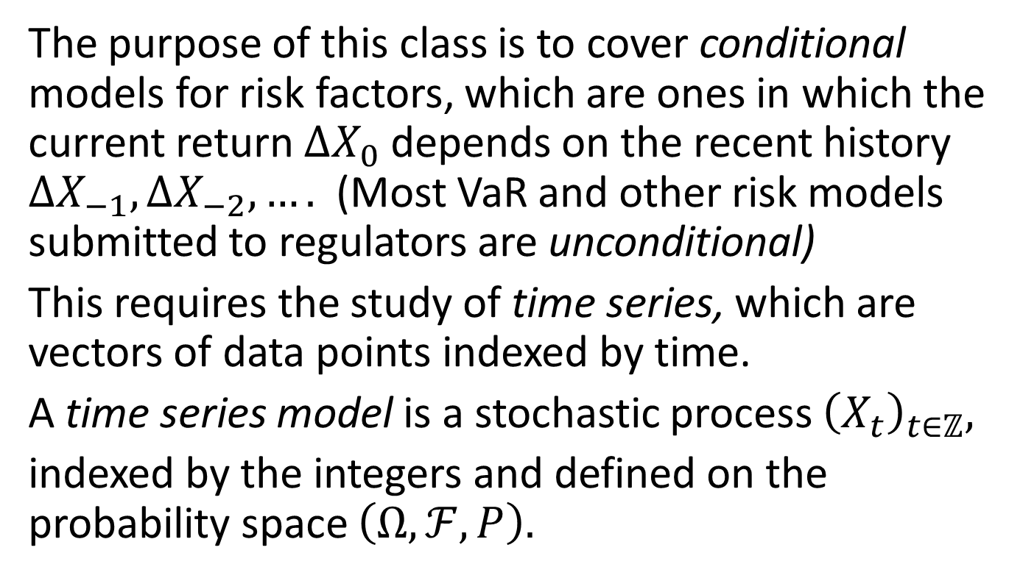
Basic Goal
The purpose of this class is to cover conditional models for risk factors, which are ones in which the current return $∆X_{0}$ depends on the recent history $∆X_{−1},∆X_{−2},….$ (Most VaR and other risk models submitted to regulators are unconditional)
This requires the study of time series, which are vectors of data points indexed by time.
A time series model is a stochastic process ${\left(X_{t}\right)}_{t∈ℤ},$
indexed by the integers and defined on the probability space $\left(Ω,ℱ,P\right).$

Slide 3
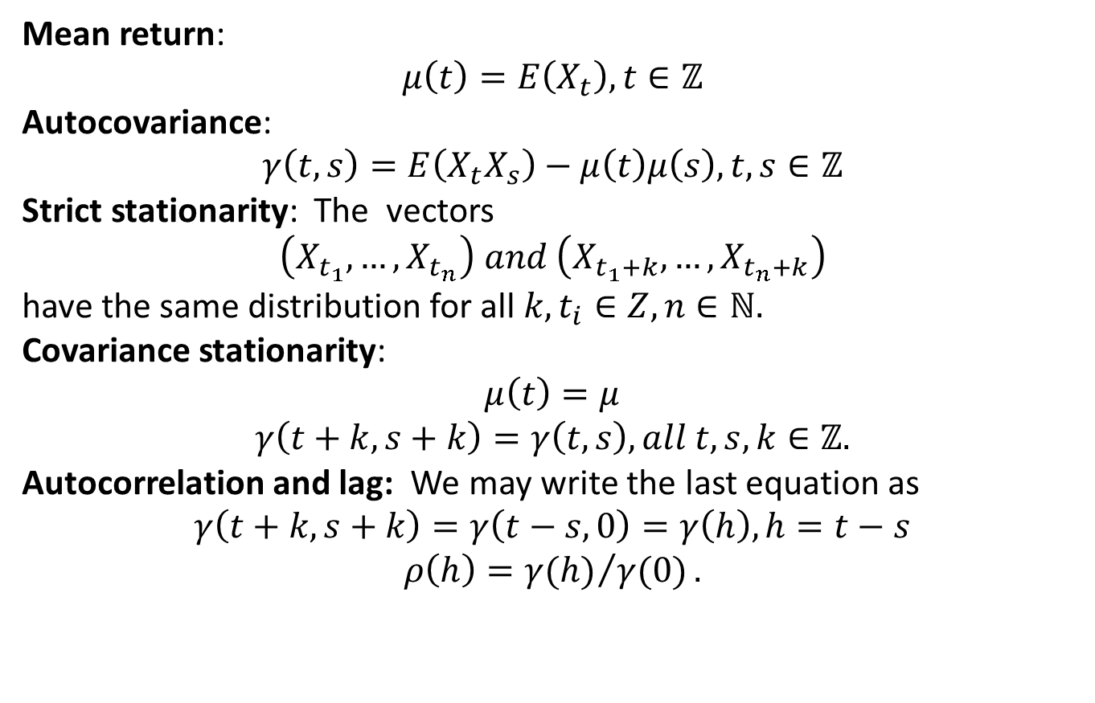
Moments and Stationarity
Mean return:
$$μ\left(t\right)=E\left(X_{t}\right), t∈ℤ$$
Autocovariance:
$$γ\left(t,s\right)=E\left(X_{t}X_{s}\right)−μ\left(t\right)μ\left(s\right), t,s∈ℤ$$
Strict stationarity: The vectors
$$\left(X_{t_{1}},…,X_{t_{n}}\right) and \left(X_{t_{1}+k},…,X_{t_{n}+k}\right)$$
have the same distribution for all $k,t_{i}∈Z, n∈ℕ.$
Covariance stationarity:
$$μ\left(t\right)=μ$$
$$γ\left(t+k,s+k\right)=γ\left(t,s\right), all t,s,k∈ℤ.$$
Autocorrelation and lag: We may write the last equation as
$$γ\left(t+k,s+k\right)=γ\left(t−s,0\right)=γ\left(h\right), h=t−s$$
$$ρ\left(h\right)={γ(h)}/{γ(0)}.$$

Slide 4
“Stylized Facts”, or things that are generally true about financial time series
Return series are not i.i.d. but show little serial correlation.
Series of absolute or squared returns show profound serial correlation.
Conditional expected returns are close to 0.
Volatility appears to vary over time.
Return series are leptokurtic or “fat-tailed”.
Extreme returns appear in clusters

Slide 5
Longer Period Returns vs Daily
As one studies progressively longer period returns, non-overlapping, moving from daily to weekly to monthly we see that
Returns become closer to i.i.d.
Returns become less fat-tailed and more normal-looking
This suggests a sort of central limit effect.

Slide 6
Multivariate Stylized Facts
Multivariate return series show little evidence of cross-correlation, except for contemporaneous returns.
Multivariate series of absolute returns show profound evidence of cross-correlation.
Correlations between series vary over time.
Extreme returns in one series often coincide with extreme returns in several other series (“misery loves company”).

Slide 7
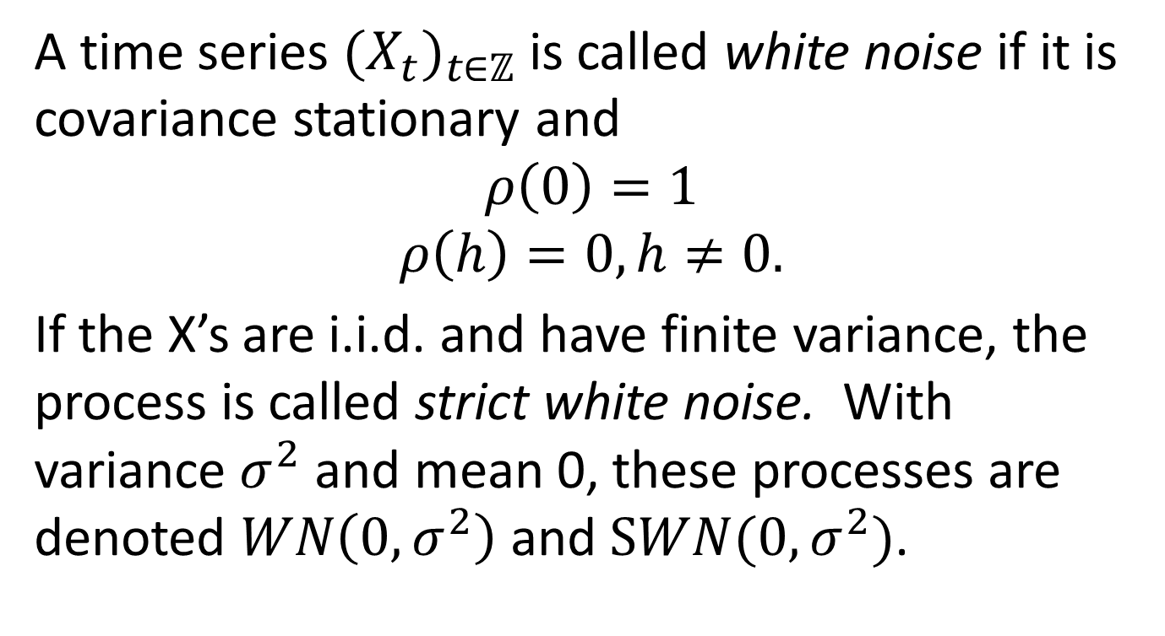
The Most Basic Time Series – White Noise
A time series ${(X_{t})}_{t∈ℤ}$ is called white noise if it is covariance stationary and
$$ρ\left(0\right)=1$$
$$ρ\left(h\right)=0, h≠0.$$
If the X’s are i.i.d. and have finite variance, the process is called strict white noise. With variance $σ^{2}$ and mean 0, these processes are denoted $WN\left(0,σ^{2}\right)$ and $SWN(0,σ^{2})$.

Slide 8
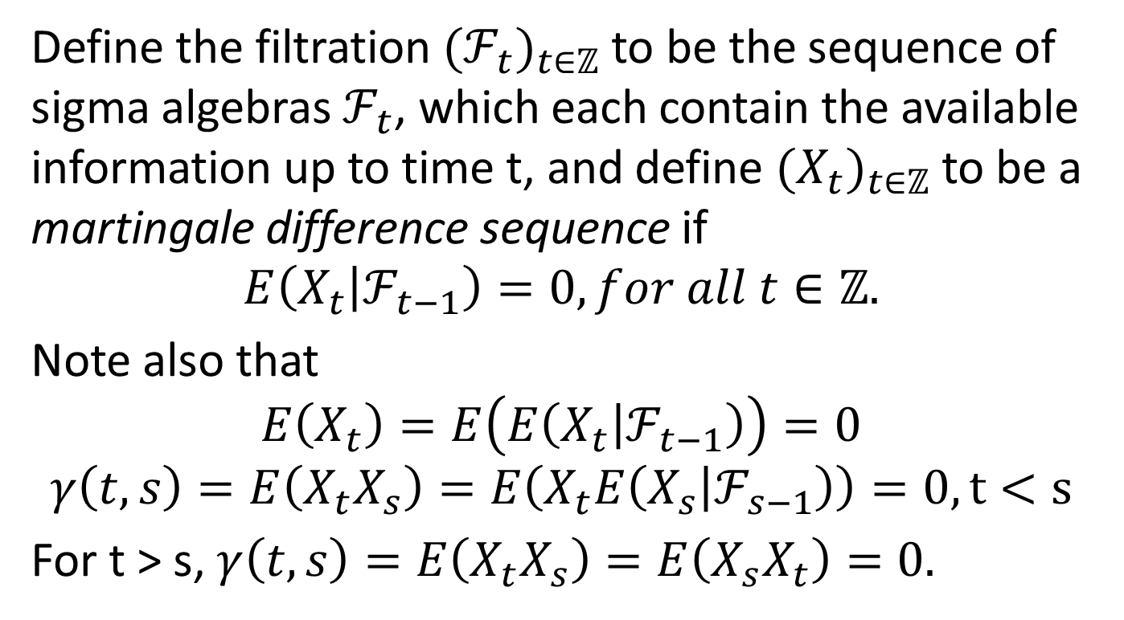
Martingale Difference Sequence
Define the filtration ${(ℱ_{t})}_{t∈ℤ}$ to be the sequence of sigma algebras $ℱ_{t}$, which each contain the available information up to time t, and define ${(X_{t})}_{t∈ℤ}$ to be a martingale difference sequence if
$$E\left(X_{t} | ℱ_{t−1}\right)=0, for all t∈ℤ.$$
Note also that
$$E\left(X_{t}\right)=E\left(E\left(X_{t} | ℱ_{t−1}\right)\right)=0$$
$$γ\left(t,s\right)=E\left(X_{t}X_{s}\right)=E\left(X_{t}E\left(X_{s} | ℱ_{s−1}\right)\right)=0, t<s$$
For t > s, $γ\left(t,s\right)=E\left(X_{t}X_{s}\right)=E\left(X_{s}X_{t}\right)=0.$

Slide 9
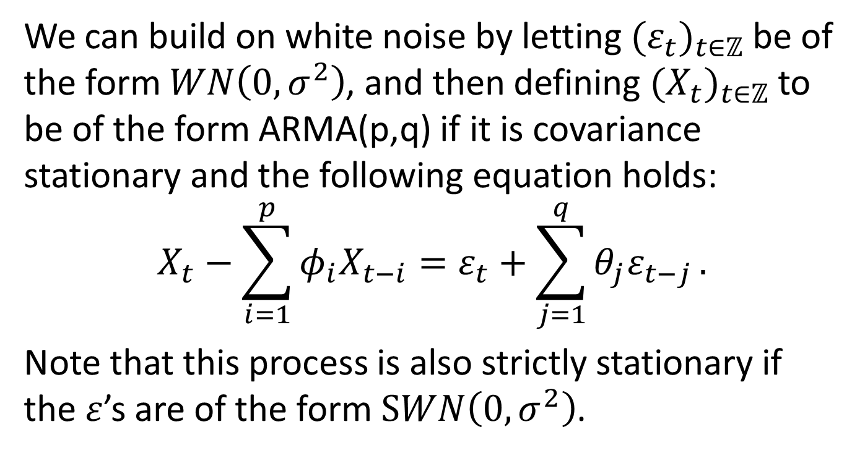
Autoregressive Moving Average Models (ARMA)
We can build on white noise by letting ${(ε_{t})}_{t∈ℤ}$ be of the form $WN\left(0,σ^{2}\right)$, and then defining ${(X_{t})}_{t∈ℤ}$ to be of the form ARMA(p,q) if it is covariance stationary and the following equation holds:
$$X_{t}−\sum_{i=1}^{p}{φ_{i}X_{t−i}}=ε_{t}+\sum_{j=1}^{q}{θ_{j}ε_{t−j}}.$$
Note that this process is also strictly stationary if the $ε$’s are of the form $SWN\left(0,σ^{2}\right)$.

Slide 10
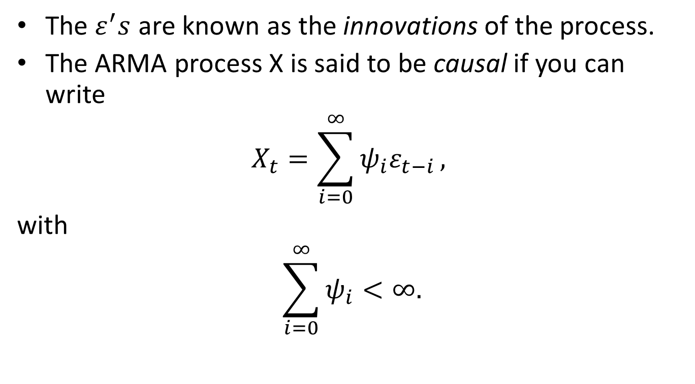
ARMA Models, Cont’d
The $ε^{′}s$ are known as the innovations of the process.
The ARMA process X is said to be causal if you can write
$$X_{t}=\sum_{i=0}^{∞}{ψ_{i}ε_{t−i}},$$
with
$$\sum_{i=0}^{∞}{ψ_{i}<∞.}$$

Slide 11
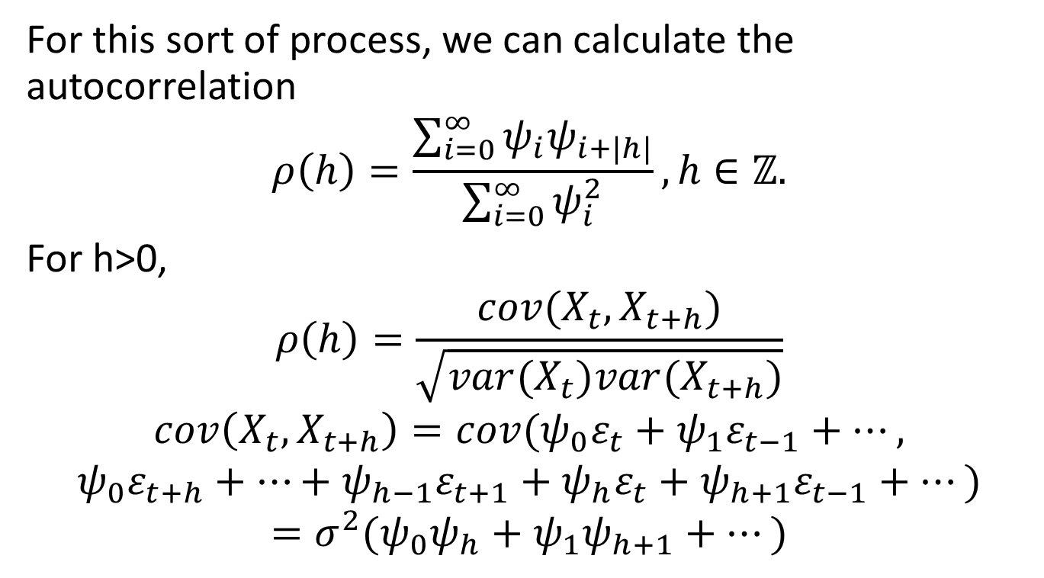
ARMA, Cont’d
For this sort of process, we can calculate the autocorrelation
$$ρ\left(h\right)=\frac{\sum_{i=0}^{∞}{ψ_{i}ψ_{i+|h|}}}{\sum_{i=0}^{∞}{ψ_{i}^{2}}},h∈ℤ.$$
For h>0,
$$ρ\left(h\right)=\frac{cov(X_{t},X_{t+h})}{\sqrt{var(X_{t})var(X_{t+h})}}$$
$$cov\left(X_{t},X_{t+h}\right)=cov(ψ_{0}ε_{t}+ψ_{1}ε_{t−1}+…,$$
$$ψ_{0}ε_{t+h}+…+ψ_{h−1}ε_{t+1}+ψ_{h}ε_{t}+ψ_{h+1}ε_{t−1}+…)$$
$$=σ^{2}(ψ_{0}ψ_{h}+ψ_{1}ψ_{h+1}+…)$$

Slide 12
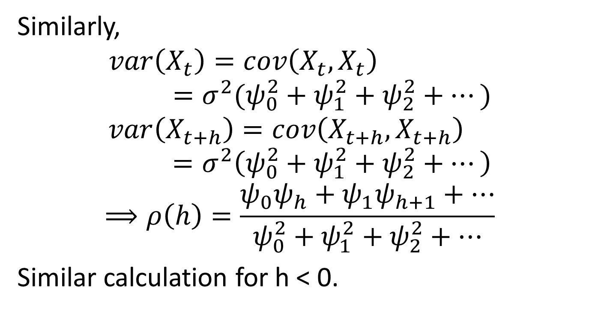
ARMA, Cont’d
Similarly,
$$var\left(X_{t}\right)=cov\left(X_{t},X_{t}\right)=σ^{2}(ψ_{0}^{2}+ψ_{1}^{2}+ψ_{2}^{2}+…)$$
$$var\left(X_{t+h}\right)=cov\left(X_{t+h},X_{t+h}\right)=σ^{2}\left(ψ_{0}^{2}+ψ_{1}^{2}+ψ_{2}^{2}+…\right)$$
$$⟹ρ\left(h\right)=\frac{ψ_{0}ψ_{h}+ψ_{1}ψ_{h+1}+…}{ψ_{0}^{2}+ψ_{1}^{2}+ψ_{2}^{2}+…}$$
Similar calculation for h < 0.

Slide 13
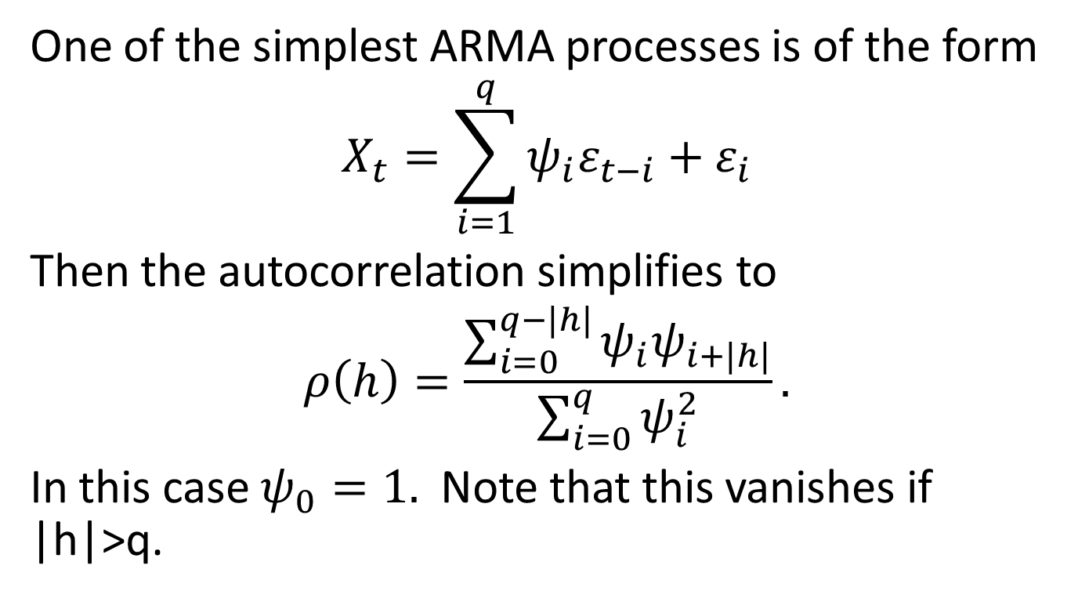
Example – MA(q) (Moving Average Process)
One of the simplest ARMA processes is of the form
$$X_{t}=\sum_{i=1}^{q}{ψ_{i}ε_{t−i}+ε_{i}}$$
Then the autocorrelation simplifies to
$$ρ\left(h\right)=\frac{\sum_{i=0}^{q−|h|}{ψ_{i}ψ_{i+|h|}}}{\sum_{i=0}^{q}{ψ_{i}^{2}}}.$$
In this case $ψ_{0}=1.$ Note that this vanishes if |h|>q.

Slide 14
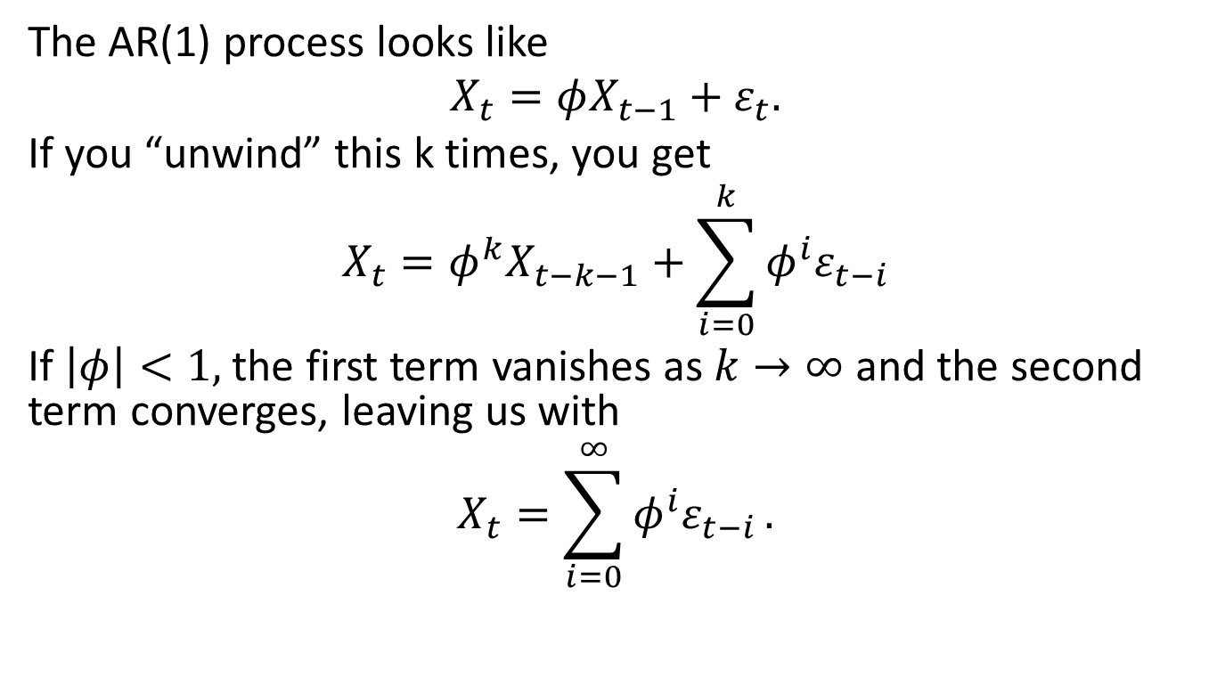
Another Simple Example
The AR(1) process looks like
$$X_{t}=φX_{t−1}+ε_{t}.$$
If you “unwind” this k times, you get
$$X_{t}=φ^{k}X_{t−k−1}+\sum_{i=0}^{k}{φ^{i}ε_{t−i}}$$
If $\left|φ\right|<1,$ the first term vanishes as $k→∞$ and the second term converges, leaving us with
$$X_{t}=\sum_{i=0}^{∞}{φ^{i}ε_{t−i}}.$$

Slide 15
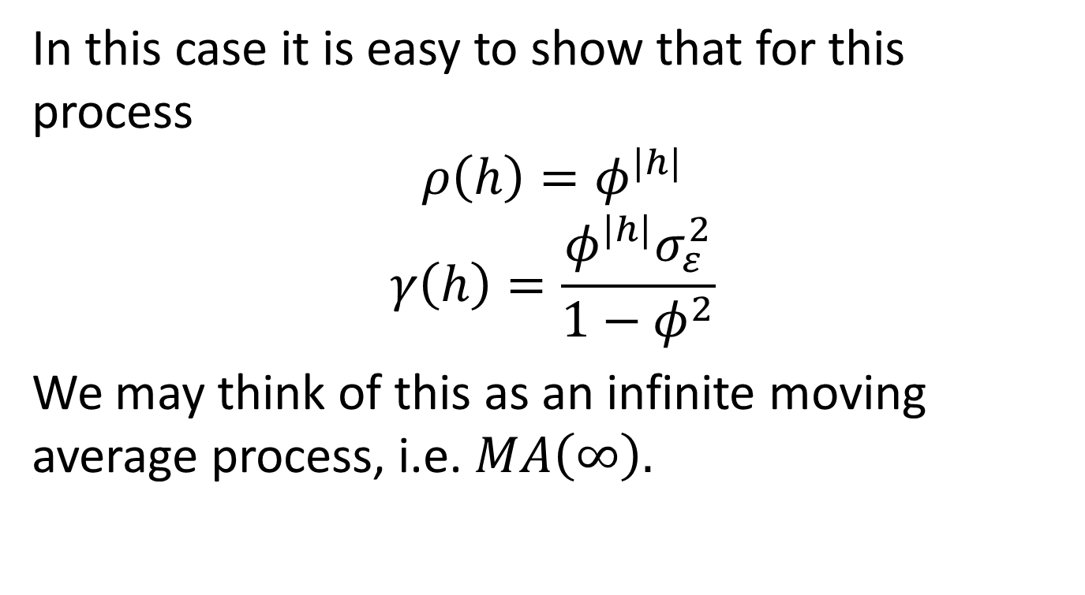
AR(1), continued
In this case it is easy to show that for this process
$$ρ\left(h\right)=φ^{|h|}$$
$$γ\left(h\right)=\frac{φ^{|h|}σ_{ε}^{2}}{1−φ^{2}}$$
We may think of this as an infinite moving average process, i.e. $MA\left(∞\right).$

Slide 16
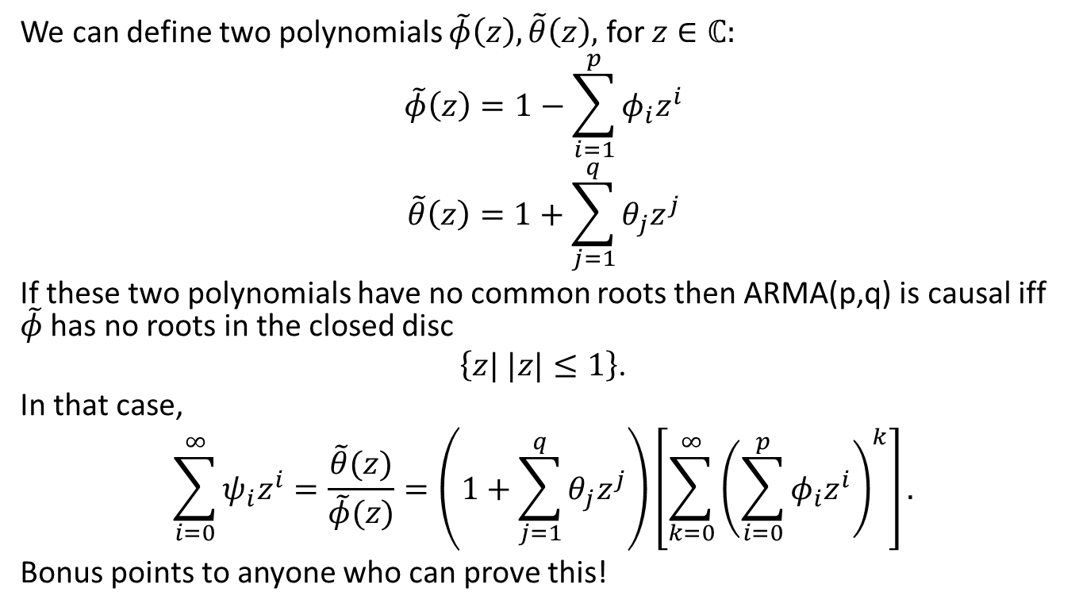
When is ARMA(p,q) Causal?
We can define two polynomials $\tilde{φ}\left(z\right),\tilde{θ}\left(z\right),$ for $z∈ℂ:$
$$\tilde{φ}\left(z\right)=1−\sum_{i=1}^{p}{φ_{i}z^{i}}$$
$$\tilde{θ}\left(z\right)=1+\sum_{j=1}^{q}{θ_{j}z^{j}}$$
If these two polynomials have no common roots then ARMA(p,q) is causal iff $\tilde{φ}$ has no roots in the closed disc
$\left\{z| |z|≤1\right\}$.
In that case,
$$\sum_{i=0}^{∞}{ψ_{i}z^{i}}=\frac{\tilde{θ}(z)}{\tilde{φ}(z)}=\left(1+\sum_{j=1}^{q}{θ_{j}z^{j}}\right)\left[\sum_{k=0}^{∞}{{\left(\sum_{i=0}^{p}{φ_{i}z^{i}}\right)}^{k}}\right].$$
Bonus points to anyone who can prove this!

Slide 17
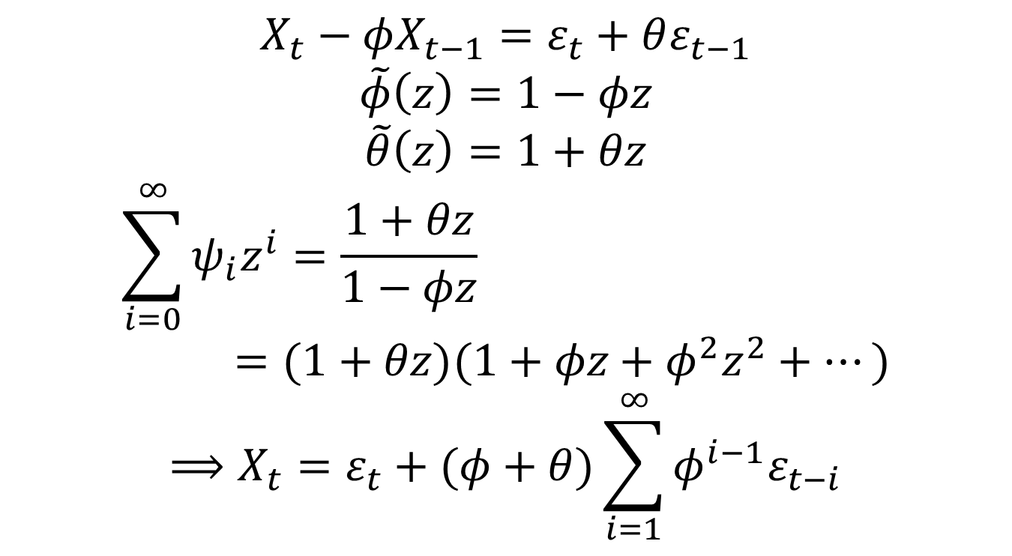
Another Example: ARMA(1,1)
$$X_{t}−φX_{t−1}=ε_{t}+θε_{t−1}$$
$$\tilde{φ}\left(z\right)=1−φz$$
$$\tilde{θ}\left(z\right)=1+θz$$
$$\sum_{i=0}^{∞}{ψ_{i}z^{i}}=\frac{1+θz}{1−φz}=(1+θz)(1+φz+φ^{2}z^{2}+…)$$
$$⟹X_{t}=ε_{t}+(φ+θ)\sum_{i=1}^{∞}{φ^{i−1}ε_{t−i}}$$

Slide 18
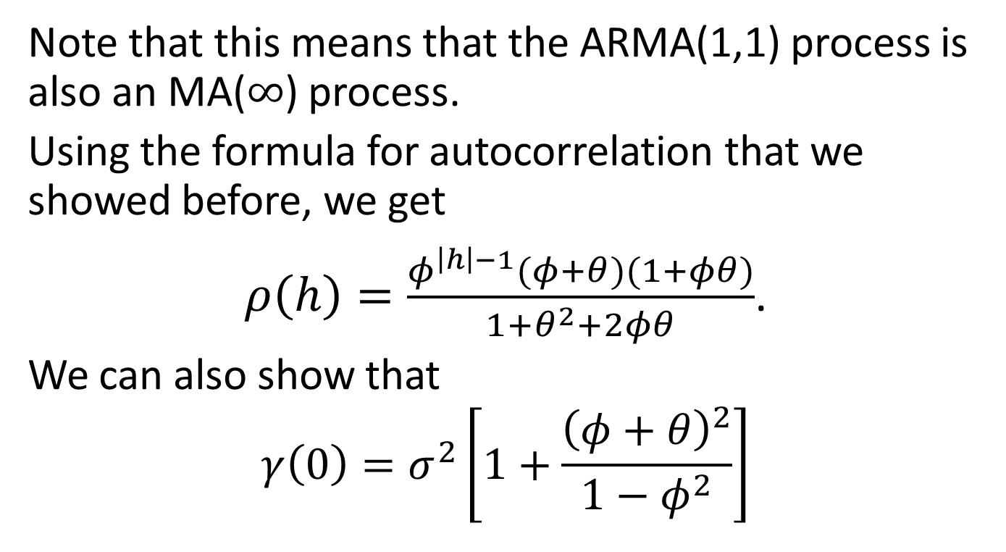
ARMA(1,1), Cont’d
Note that this means that the ARMA(1,1) process is also an MA($∞$) process.
Using the formula for autocorrelation that we showed before, we get
$ρ\left(h\right)=\frac{φ^{\left|h\right|−1}(φ+θ)(1+φθ)}{1+θ^{2}+2φθ}$.
We can also show that
$$γ\left(0\right)=σ^{2}\left[1+\frac{{\left(φ+θ\right)}^{2}}{1−φ^{2}}\right]$$

Slide 19
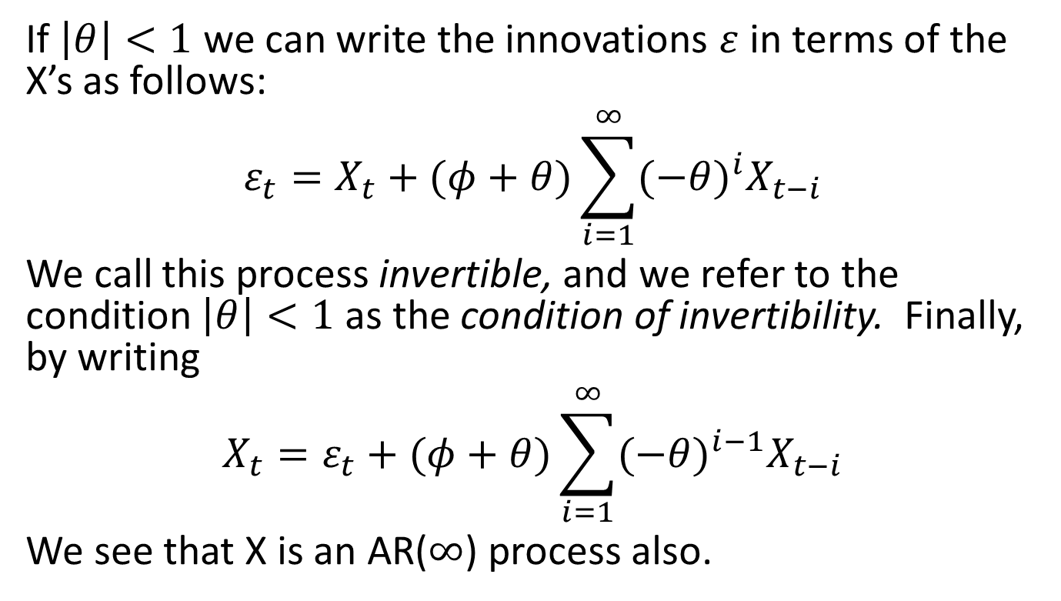
Invertibility
If $\left|θ\right|<1$ we can write the innovations $ε$ in terms of the X’s as follows:
$$ε_{t}=X_{t}+(φ+θ)\sum_{i=1}^{∞}{{(−θ)}^{i}X_{t−i}}$$
We call this process invertible, and we refer to the condition $\left|θ\right|<1$ as the condition of invertibility. Finally, by writing
$$X_{t}=ε_{t}+(φ+θ)\sum_{i=1}^{∞}{{(−θ)}^{i−1}X_{t−i}}$$
We see that X is an AR($∞$) process also.

Slide 20
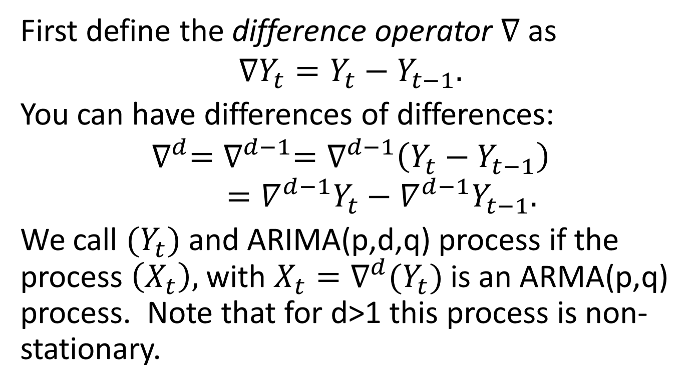
Autoregressive Integrated Moving Average (ARIMA) Model
First define the difference operator $∇$ as
$$∇Y_{t}=Y_{t}−Y_{t−1}.$$
You can have differences of differences:
$$∇^{d}=∇^{d−1}=∇^{d−1}\left(Y_{t}−Y_{t−1}\right)=∇^{d−1}Y_{t}−∇^{d−1}Y_{t−1}.$$
We call $(Y_{t})$ and ARIMA(p,d,q) process if the process $\left(X_{t}\right),$ with $X_{t}=∇^{d}(Y_{t})$ is an ARMA(p,q) process. Note that for d>1 this process is non-stationary.

Slide 21
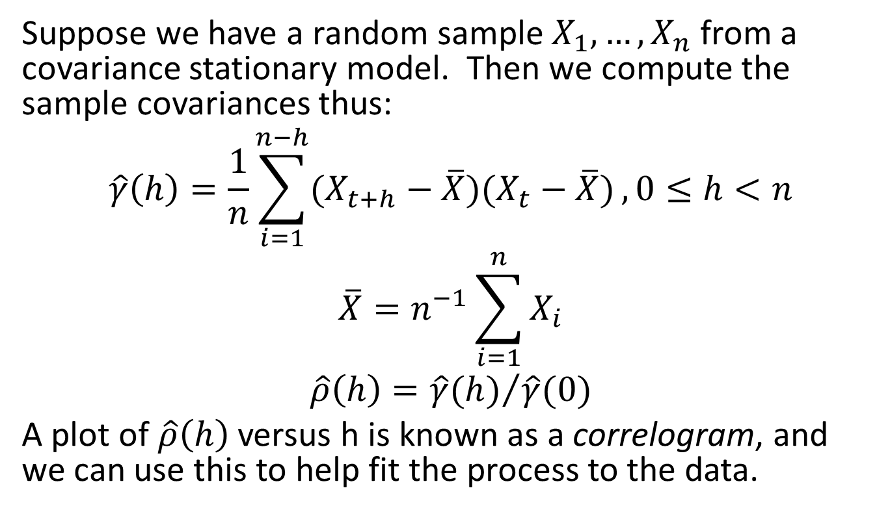
Sample Autocovariances
Suppose we have a random sample $X_{1},…,X_{n}$ from a covariance stationary model. Then we compute the sample covariances thus:
$$\hat{γ}\left(h\right)=\frac{1}{n}\sum_{i=1}^{n−h}{(X_{t+h}−\overline{X})(X_{t}−\overline{X})},0≤h<n$$
$$\overline{X}=n^{−1}\sum_{i=1}^{n}{X_{i}}$$
$$\hat{ρ}\left(h\right)={\hat{γ}(h)}/{\hat{γ}(0)}$$
A plot of $\hat{ρ}\left(h\right)$ versus h is known as a correlogram, and we can use this to help fit the process to the data.

Slide 22
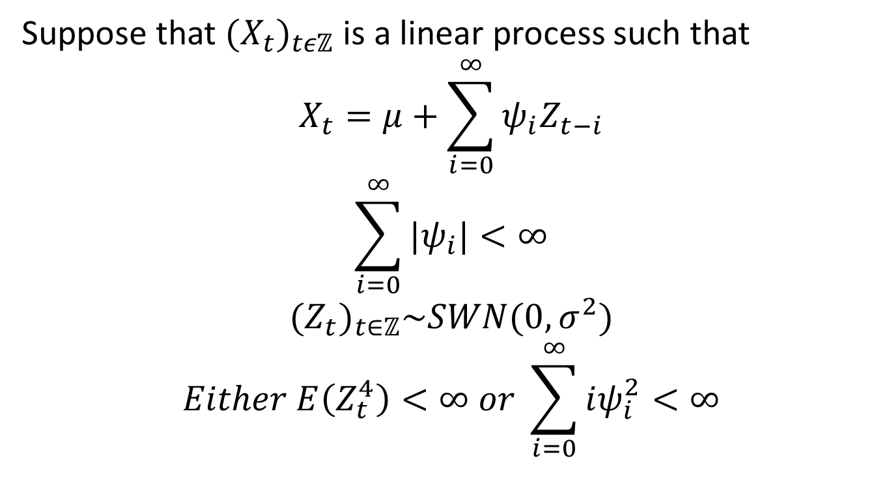
A “Central Limit Theorem” for Linear Processes
Suppose that ${(X_{t})}_{tεℤ}$ is a linear process such that
$$X_{t}=μ+\sum_{i=0}^{∞}{ψ_{i}Z_{t−i}}$$
$$\sum_{i=0}^{∞}{|ψ_{i}|}<∞$$
$${(Z_{t})}_{t∈ℤ}\sim SWN(0,σ^{2})$$
$$Either E\left(Z_{t}^{4}\right)<∞ or \sum_{i=0}^{∞}{iψ_{i}^{2}}<∞$$

Slide 23
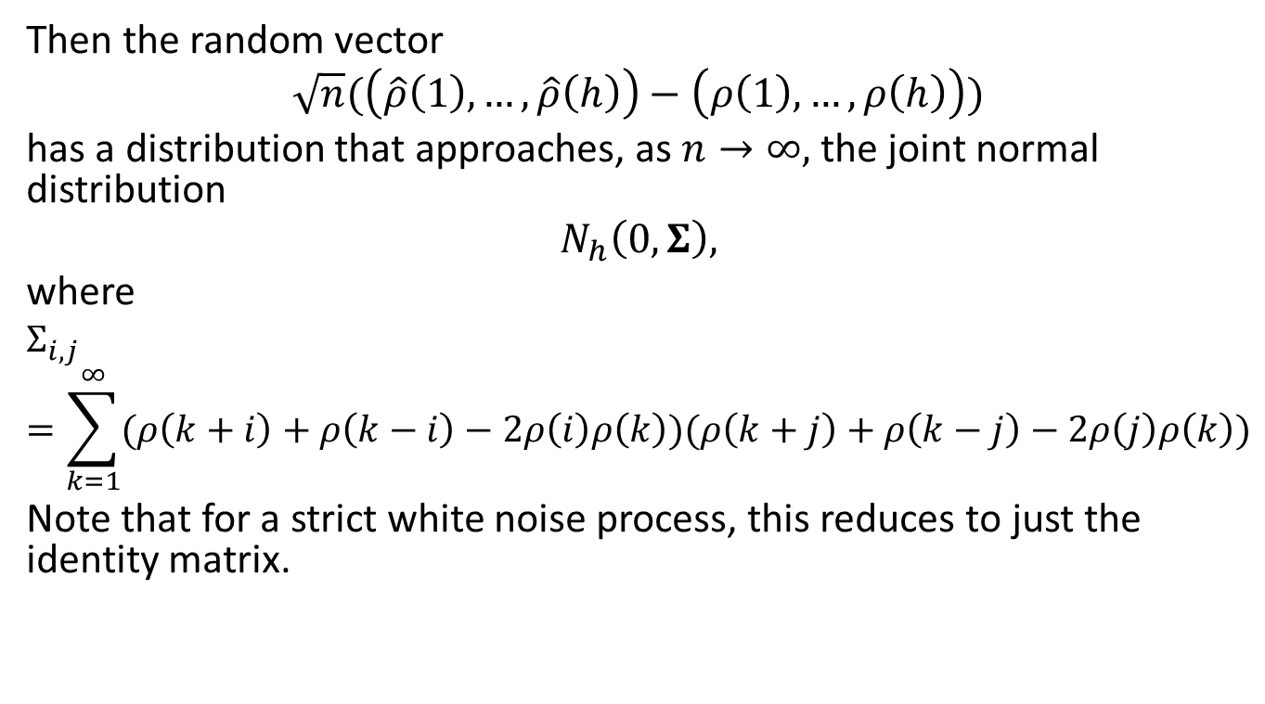
Linear Process, cont’d
Then the random vector
$$\sqrt{n}(\left(\hat{ρ}\left(1\right),…,\hat{ρ}\left(h\right)\right)−\left(ρ\left(1\right),…, ρ\left(h\right)\right))$$
has a distribution that approaches, as $n→∞,$ the joint normal distribution
$$N_{h}\left(0,Σ\right),$$
where
$$Σ_{i,j}=\sum_{k=1}^{∞}{(ρ\left(k+i\right)+ρ\left(k−i\right)−2ρ\left(i\right)ρ\left(k\right))(ρ\left(k+j\right)+ρ\left(k−j\right)−2ρ\left(j\right)ρ\left(k\right))}$$
Note that for a strict white noise process, this reduces to just the identity matrix.

Slide 24
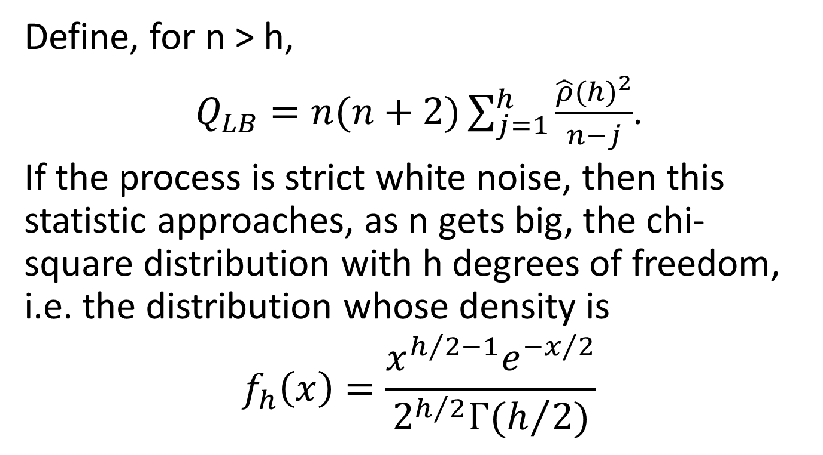
Is it Strict White Noise? – the Ljung-Box Test
Define, for n > h,
$Q_{LB}=n(n+2)\sum_{j=1}^{h}{\frac{{\hat{ρ}(h)}^{2}}{n−j}}$.
If the process is strict white noise, then this statistic approaches, as n gets big, the chi-square distribution with h degrees of freedom, i.e. the distribution whose density is
$$f_{h}\left(x\right)=\frac{x^{h/2−1}e^{{−x}/2}}{2^{h/2}Γ(h/2)}$$

Slide 25
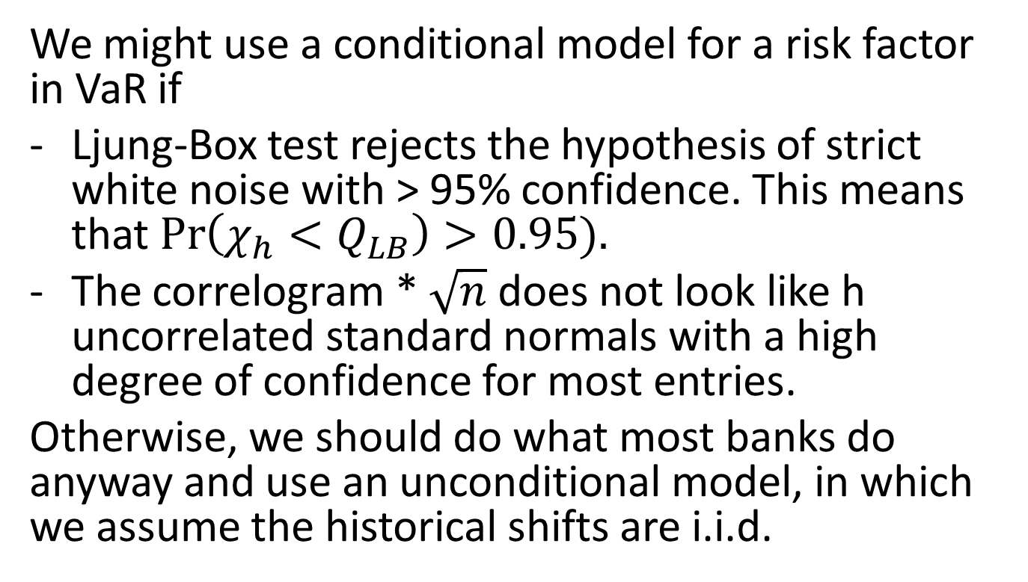
Is the Risk Factor Conditional or Unconditional?
We might use a conditional model for a risk factor in VaR if
Ljung-Box test rejects the hypothesis of strict white noise with > 95% confidence. This means that $\operatorname{Pr}\left(χ_{h}<Q_{LB}\right)>0.95).$
The correlogram * $\sqrt{n}$ does not look like h uncorrelated standard normals with a high degree of confidence for most entries.
Otherwise, we should do what most banks do anyway and use an unconditional model, in which we assume the historical shifts are i.i.d.

Slide 26
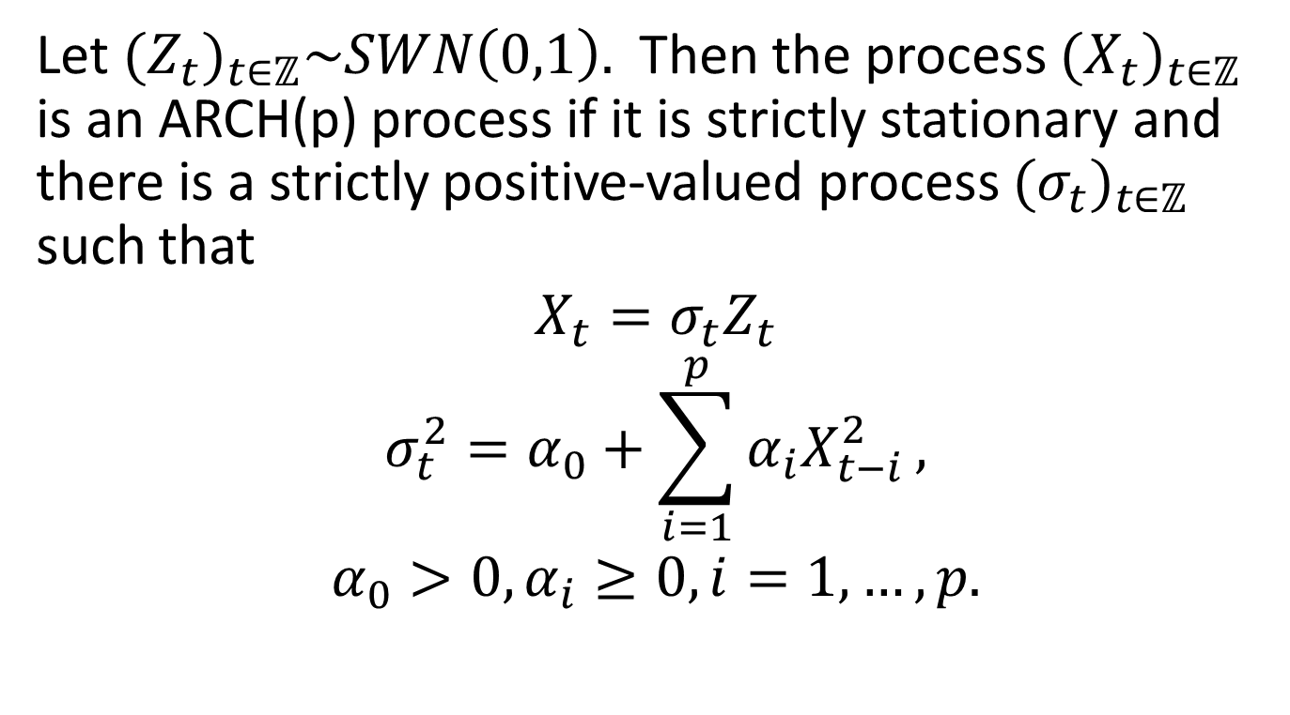
Autoregressive Conditionally Heteroskedastic (ARCH) Model
Let ${(Z_{t})}_{t∈ℤ}\sim SWN\left(0,1\right).$ Then the process ${(X_{t})}_{t∈ℤ}$ is an ARCH(p) process if it is strictly stationary and there is a strictly positive-valued process ${(σ_{t})}_{t∈ℤ}$ such that
$$X_{t}=σ_{t}Z_{t}$$
$$σ_{t}^{2}=α_{0}+\sum_{i=1}^{p}{α_{i}X_{t−i}^{2}},$$
$$α_{0}>0, α_{i}≥0, i=1,…,p.$$

Slide 27
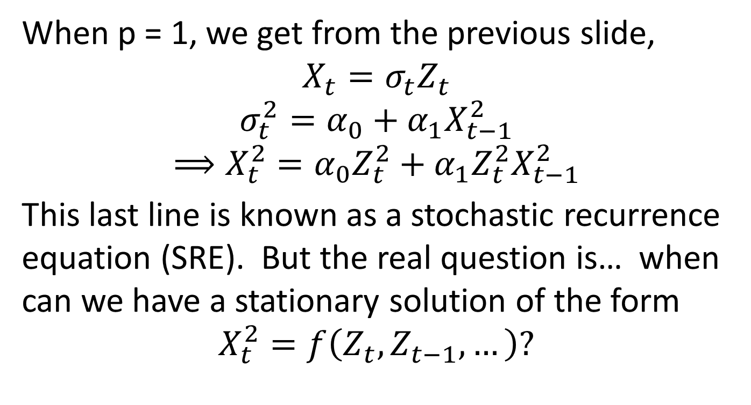
Important Example – ARCH(1)
When p = 1, we get from the previous slide,
$$X_{t}=σ_{t}Z_{t}$$
$$σ_{t}^{2}=α_{0}+α_{1}X_{t−1}^{2}$$
$$⟹X_{t}^{2}=α_{0}Z_{t}^{2}+α_{1}Z_{t}^{2}X_{t−1}^{2}$$
This last line is known as a stochastic recurrence equation (SRE). But the real question is… when can we have a stationary solution of the form
$$X_{t}^{2}=f\left(Z_{t},Z_{t−1},…\right)?$$

Slide 28
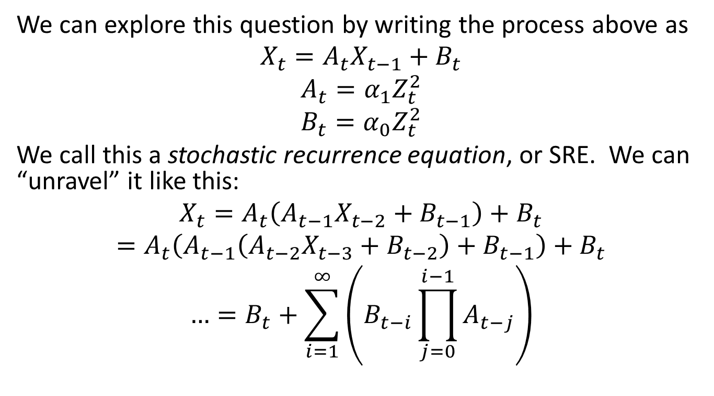
ARCH(1), Continued
We can explore this question by writing the process above as
$$X_{t}=A_{t}X_{t−1}+B_{t}$$
$$A_{t}=α_{1}Z_{t}^{2}$$
$$B_{t}=α_{0}Z_{t}^{2}$$
We call this a stochastic recurrence equation, or SRE. We can “unravel” it like this:
$$X_{t}=A_{t}\left(A_{t−1}X_{t−2}+B_{t−1}\right)+B_{t}$$
$$=A_{t}\left(A_{t−1}\left(A_{t−2}X_{t−3}+B_{t−2}\right)+B_{t−1}\right)+B_{t}$$
$$…=B_{t}+\sum_{i=1}^{∞}{\left(B_{t−i}\prod_{j=0}^{i−1}{A_{t−j}}\right)}$$

Slide 29
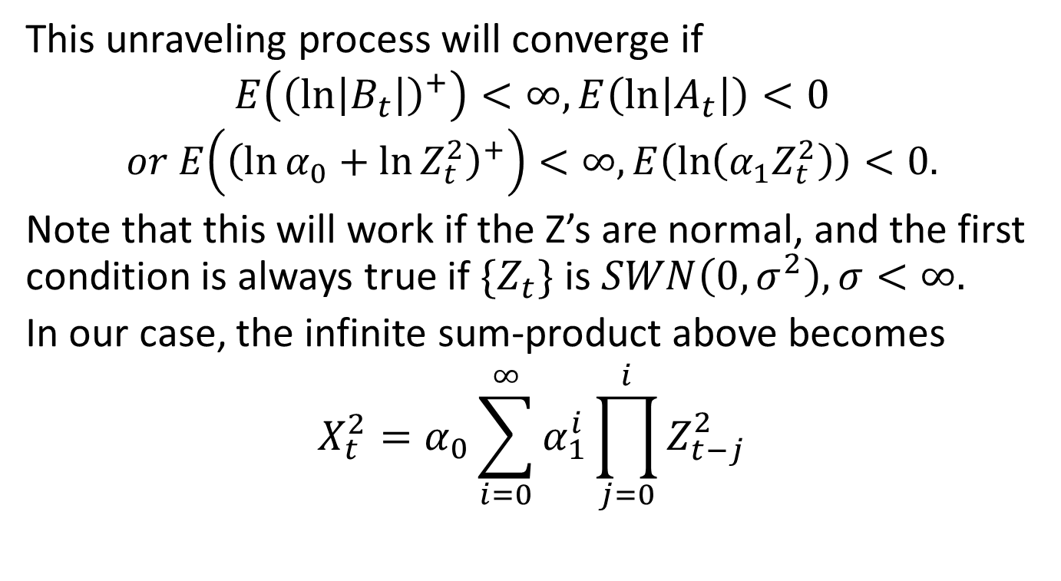
ARCH(1), Continued
This unraveling process will converge if
$$E\left({\left(ln\left|B_{t}\right|\right)}^{+}\right)<∞, E\left(\ln\left|A_{t}\right|\right)<0$$
$$or E\left({\left(\ln{α_{0}}+\ln{Z_{t}^{2}}\right)}^{+}\right)<∞, E\left(\ln\left(α_{1}Z_{t}^{2}\right)\right)<0.$$
Note that this will work if the Z’s are normal, and the first condition is always true if $\{Z_{t}\}$ is $SWN\left(0,σ^{2}\right), σ<∞.$
In our case, the infinite sum-product above becomes
$$X_{t}^{2}=α_{0}\sum_{i=0}^{∞}{α_{1}^{i}\prod_{j=0}^{i}{Z_{t−j}^{2}}}$$

Slide 30
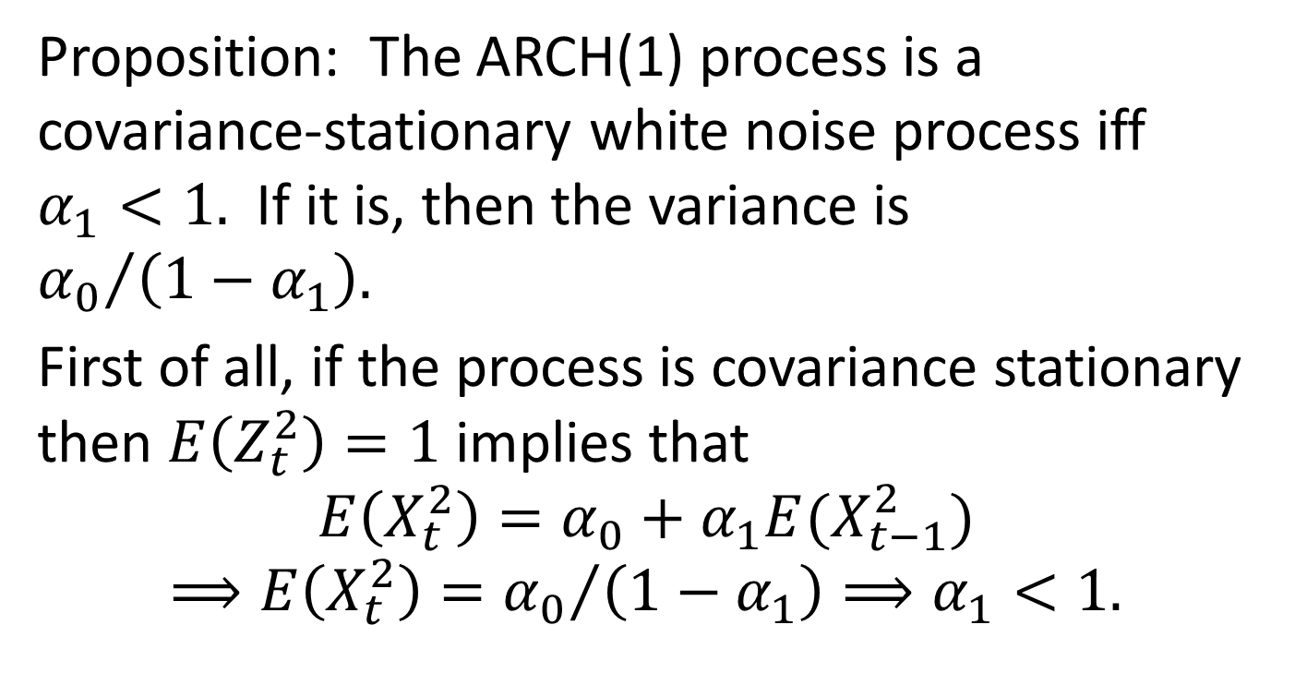
When is ARCH(1) White Noise?
Proposition: The ARCH(1) process is a covariance-stationary white noise process iff $α_{1}<1.$ If it is, then the variance is ${α_{0}}/{\left({1−α}_{1}\right).}$
First of all, if the process is covariance stationary then $E\left(Z_{t}^{2}\right)=1$ implies that
$$E\left(X_{t}^{2}\right)=α_{0}+α_{1}E(X_{t−1}^{2})$$
$$⟹E\left(X_{t}^{2}\right)={α_{0}}/{\left(1−α_{1}\right)}⟹α_{1}<1.$$

Slide 31
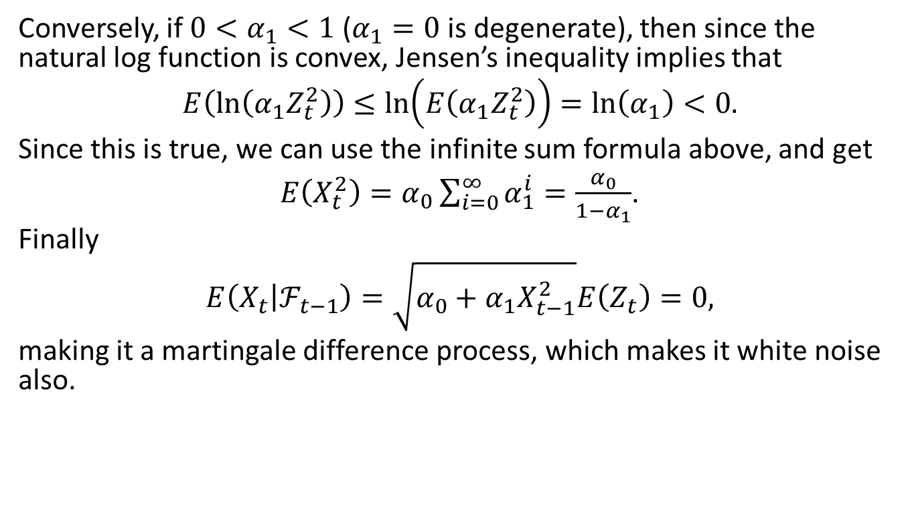
Is ARCH(1) White Noise, cont’d
Conversely, if $0<α_{1}<1$ ($α_{1}=0$ is degenerate), then since the natural log function is convex, Jensen’s inequality implies that
$$E\left(\ln\left(α_{1}Z_{t}^{2}\right)\right)≤\ln\left(E\left(α_{1}Z_{t}^{2}\right)\right)=\ln\left(α_{1}\right)<0.$$
Since this is true, we can use the infinite sum formula above, and get
$E\left(X_{t}^{2}\right)=α_{0}\sum_{i=0}^{∞}{α_{1}^{i}}=\frac{α_{0}}{1−α_{1}}$.
Finally
$$E\left(X_{t} | ℱ_{t−1}\right)=\sqrt{α_{0}+α_{1}X_{t−1}^{2}}E\left(Z_{t}\right)=0,$$
making it a martingale difference process, which makes it white noise also.

Slide 32
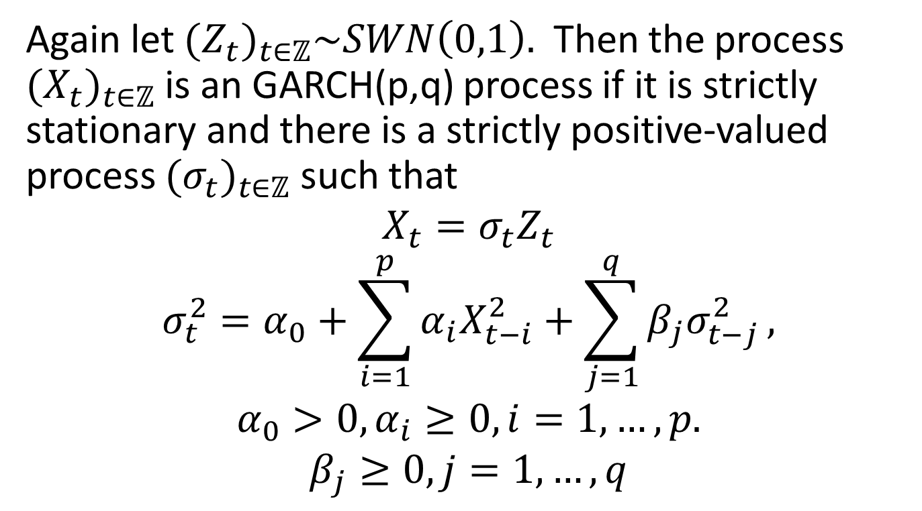
Generalized ARCH Models (GARCH)
Again let ${(Z_{t})}_{t∈ℤ}\sim SWN\left(0,1\right).$ Then the process ${(X_{t})}_{t∈ℤ}$ is an GARCH(p,q) process if it is strictly stationary and there is a strictly positive-valued process ${(σ_{t})}_{t∈ℤ}$ such that
$$X_{t}=σ_{t}Z_{t}$$
$$σ_{t}^{2}=α_{0}+\sum_{i=1}^{p}{α_{i}X_{t−i}^{2}}+\sum_{j=1}^{q}{β_{j}σ_{t−j}^{2}},$$
$$α_{0}>0, α_{i}≥0, i=1,…,p.$$
$$β_{j}≥0, j=1,…,q$$

Slide 33
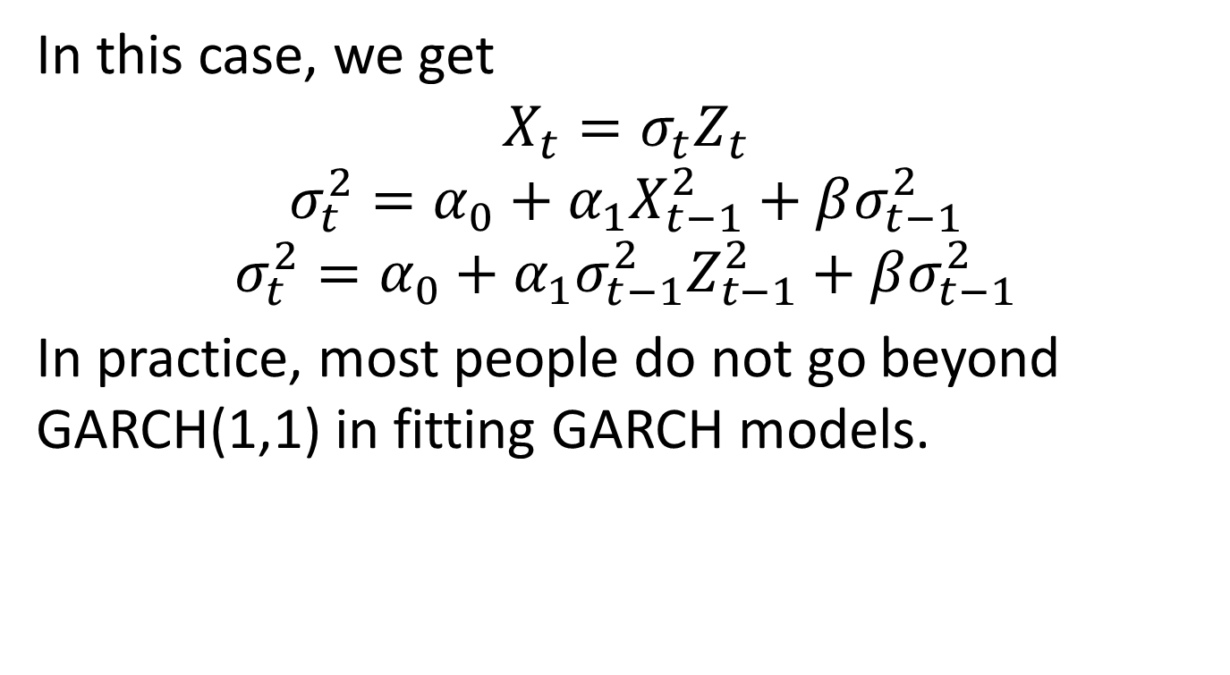
Example – GARCH(1,1)
In this case, we get
$$X_{t}=σ_{t}Z_{t}$$
$$σ_{t}^{2}=α_{0}+α_{1}X_{t−1}^{2}+βσ_{t−1}^{2}$$
$$σ_{t}^{2}=α_{0}+α_{1}{σ_{t−1}^{2}Z}_{t−1}^{2}+βσ_{t−1}^{2}$$
In practice, most people do not go beyond GARCH(1,1) in fitting GARCH models.

Slide 34
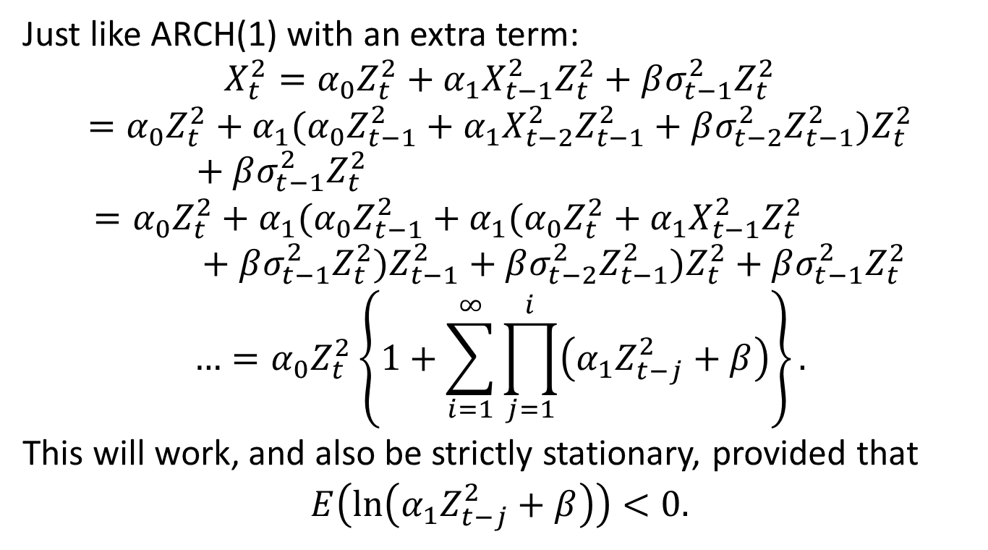
Unraveling GARCH(1,1)
Just like ARCH(1) with an extra term:
$$X_{t}^{2}=α_{0}Z_{t}^{2}+α_{1}X_{t−1}^{2}Z_{t}^{2}+βσ_{t−1}^{2}Z_{t}^{2}$$
$$=α_{0}Z_{t}^{2}+α_{1}(α_{0}Z_{t−1}^{2}+α_{1}X_{t−2}^{2}Z_{t−1}^{2}+βσ_{t−2}^{2}Z_{t−1}^{2})Z_{t}^{2}+βσ_{t−1}^{2}Z_{t}^{2}$$
$$=α_{0}Z_{t}^{2}+α_{1}(α_{0}Z_{t−1}^{2}+α_{1}(α_{0}Z_{t}^{2}+α_{1}X_{t−1}^{2}Z_{t}^{2}+βσ_{t−1}^{2}Z_{t}^{2})Z_{t−1}^{2}+βσ_{t−2}^{2}Z_{t−1}^{2})Z_{t}^{2}+βσ_{t−1}^{2}Z_{t}^{2}$$
$$…=α_{0}Z_{t}^{2}\left\{1+\sum_{i=1}^{∞}{\prod_{j=1}^{i}{\left(α_{1}Z_{t−j}^{2}+β\right)}}\right\}.$$
This will work, and also be strictly stationary, provided that
$E\left(\ln\left(α_{1}Z_{t−j}^{2}+β\right)\right)<0.$

Slide 35
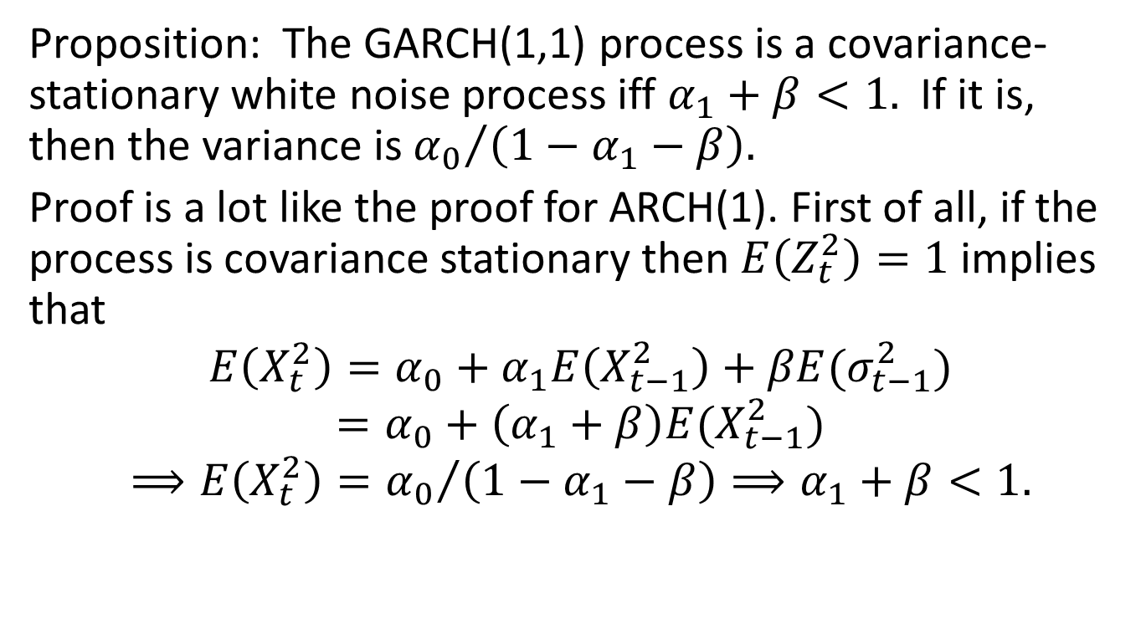
When is it White Noise?
Proposition: The GARCH(1,1) process is a covariance-stationary white noise process iff $α_{1}+β<1.$ If it is, then the variance is ${α_{0}}/{\left({1−α}_{1}−β\right).}$
Proof is a lot like the proof for ARCH(1). First of all, if the process is covariance stationary then $E\left(Z_{t}^{2}\right)=1$ implies that
$$E\left(X_{t}^{2}\right)=α_{0}+α_{1}E\left(X_{t−1}^{2}\right)+βE(σ_{t−1}^{2})$$
$$=α_{0}+\left(α_{1}+β\right)E(X_{t−1}^{2})$$
$$⟹E\left(X_{t}^{2}\right)={α_{0}}/{\left(1−α_{1}−β\right)}⟹α_{1}+β<1.$$

Slide 36
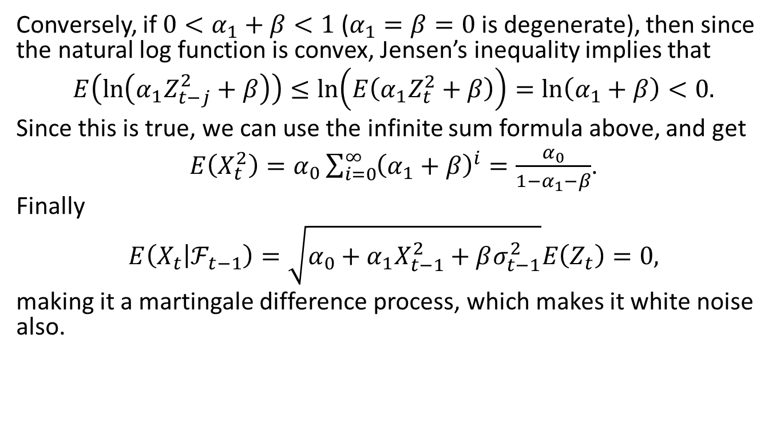
Is GARCH(1,1) White Noise, cont’d
Conversely, if $0<α_{1}+β<1$ ($α_{1}=β=0$ is degenerate), then since the natural log function is convex, Jensen’s inequality implies that
$$E\left(\ln\left(α_{1}Z_{t−j}^{2}+β\right)\right)≤\ln\left(E\left(α_{1}Z_{t}^{2}+β\right)\right)=\ln\left(α_{1}+β\right)<0.$$
Since this is true, we can use the infinite sum formula above, and get
$E\left(X_{t}^{2}\right)=α_{0}\sum_{i=0}^{∞}{{\left(α_{1}+β\right)}^{i}}=\frac{α_{0}}{1−α_{1}−β}$.
Finally
$$E\left(X_{t} | ℱ_{t−1}\right)=\sqrt{α_{0}+α_{1}X_{t−1}^{2}+βσ_{t−1}^{2}}E\left(Z_{t}\right)=0,$$
making it a martingale difference process, which makes it white noise also.

Slide 37
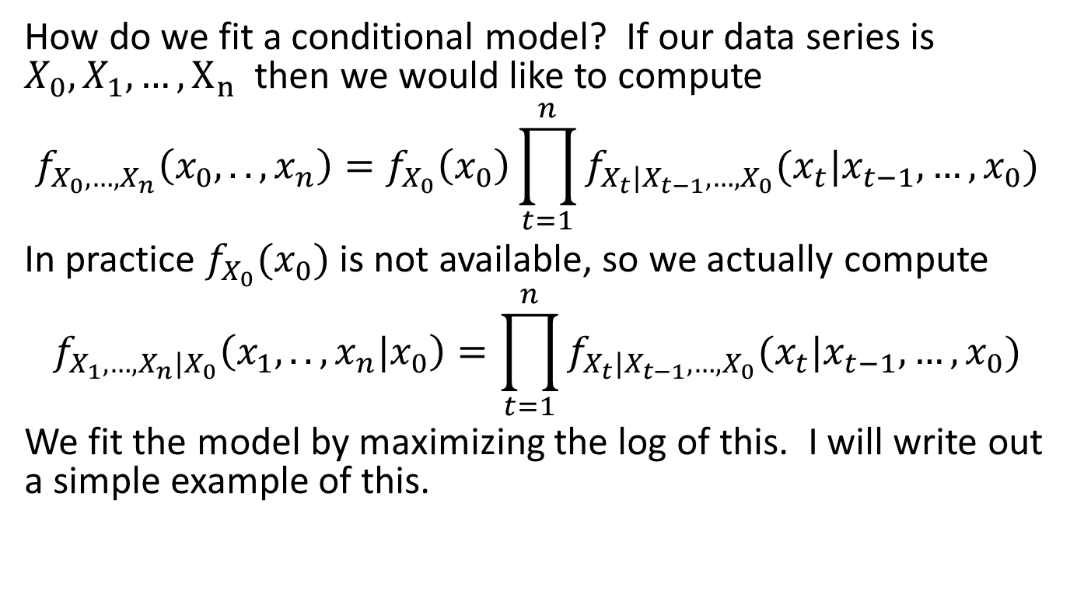
Conditional Log Likelihood
How do we fit a conditional model? If our data series is $X_{0},X_{1},…,X_{n}$ then we would like to compute
$$f_{X_{0},…,X_{n}}\left(x_{0},..,x_{n}\right)=f_{X_{0}}\left(x_{0}\right)\prod_{t=1}^{n}{f_{X_{t}|X_{t−1},…,X_{0}}(x_{t}|x_{t−1},…,x_{0})}$$
In practice $f_{X_{0}}(x_{0})$ is not available, so we actually compute
$$f_{X_{1},…,X_{n}|X_{0}}\left(x_{1},..,x_{n}|x_{0}\right)=\prod_{t=1}^{n}{f_{X_{t}|X_{t−1},…,X_{0}}(x_{t}|x_{t−1},…,x_{0})}$$
We fit the model by maximizing the log of this. I will write out a simple example of this.

Slide 38
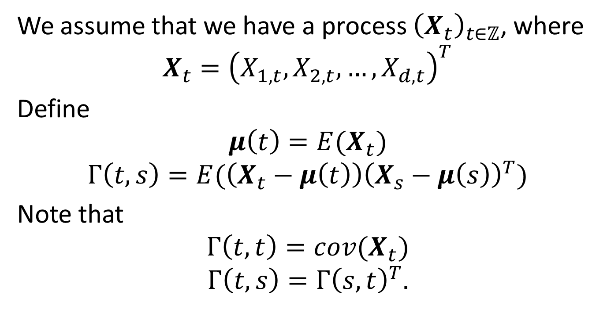
Multivariate Conditional Models
We assume that we have a process ${\left(X_{t}\right)}_{t∈ℤ}$, where
$$X_{t}={\left(X_{1,t},X_{2,t},…,X_{d,t}\right)}^{T}$$
Define
$$μ\left(t\right)=E(X_{t})$$
$$Γ\left(t,s\right)=E(\left(X_{t}−μ\left(t\right)\right){\left(X_{s}−μ\left(s\right)\right)}^{T})$$
Note that
$$Γ\left(t,t\right)=cov(X_{t})$$
$$Γ\left(t,s\right)=Γ{\left(s,t\right)}^{T}.$$

Slide 39
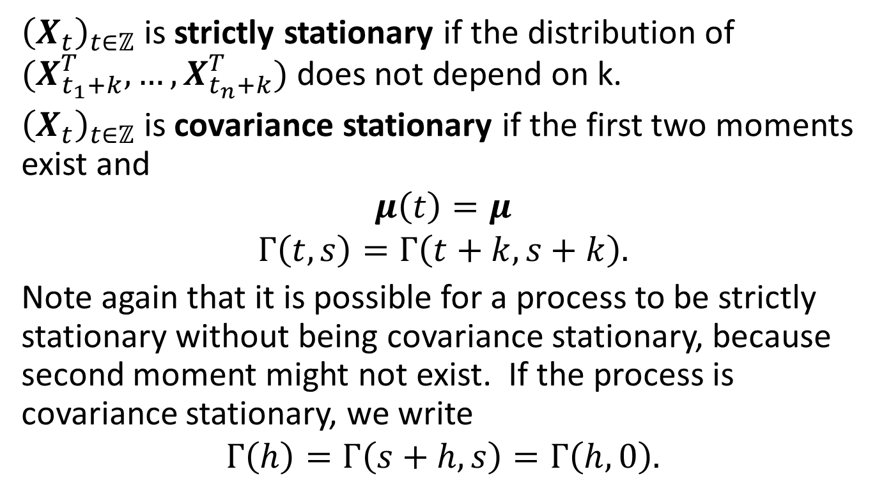
Important Properties
${\left(X_{t}\right)}_{t∈ℤ}$ is strictly stationary if the distribution of $(X_{t_{1}+k}^{T},…, X_{t_{n}+k}^{T})$ does not depend on k.
${\left(X_{t}\right)}_{t∈ℤ}$ is covariance stationary if the first two moments exist and
$$μ\left(t\right)=μ$$
$$Γ\left(t,s\right)=Γ\left(t+k,s+k\right).$$
Note again that it is possible for a process to be strictly stationary without being covariance stationary, because second moment might not exist. If the process is covariance stationary, we write
$$Γ\left(h\right)=Γ\left(s+h,s\right)=Γ\left(h,0\right).$$

Slide 40
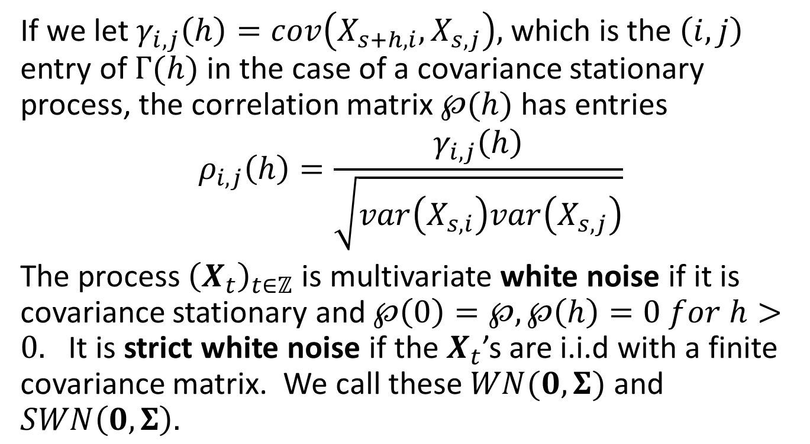
Correlation Matrix and White Noise
If we let $γ_{i,j}\left(h\right)=cov\left(X_{s+h,i},X_{s,j}\right),$ which is the $\left(i,j\right)$ entry of $Γ(h)$ in the case of a covariance stationary process, the correlation matrix $℘(h)$ has entries
$$ρ_{i,j}\left(h\right)=\frac{γ_{i,j}\left(h\right)}{\sqrt{var\left(X_{s,i}\right)var\left(X_{s,j}\right)}}$$
The process ${\left(X_{t}\right)}_{t∈ℤ}$ is multivariate white noise if it is covariance stationary and $℘\left(0\right)=℘, ℘\left(h\right)=0 for h>0.$ It is strict white noise if the $X_{t}$’s are i.i.d with a finite covariance matrix. We call these $WN(0,Σ)$ and $SWN\left(0,Σ\right).$

Slide 41
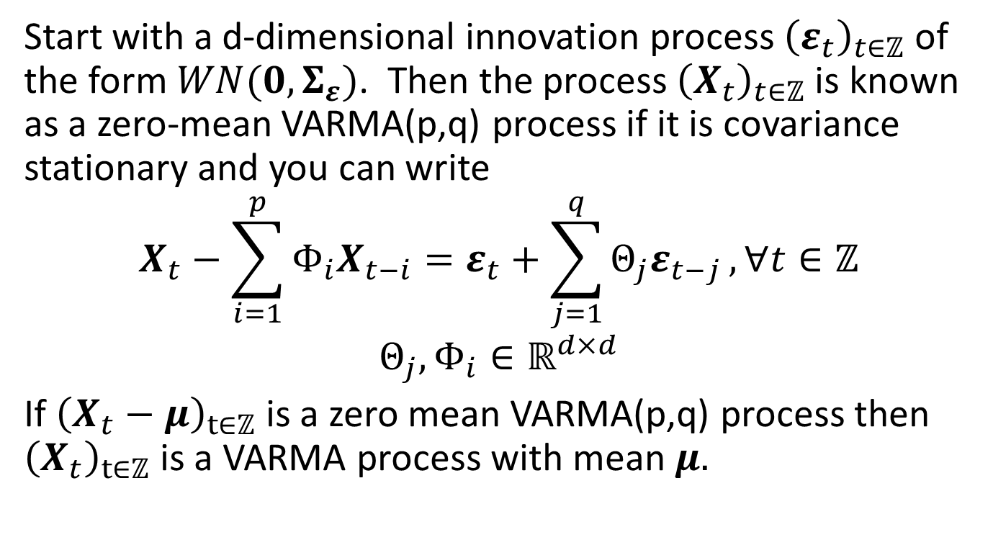
Vector ARMA Process
Start with a d-dimensional innovation process ${\left(ε_{t}\right)}_{t∈ℤ}$ of the form $WN(0,Σ_{ε})$. Then the process ${\left(X_{t}\right)}_{t∈ℤ}$ is known as a zero-mean VARMA(p,q) process if it is covariance stationary and you can write
$$X_{t}−\sum_{i=1}^{p}{Φ_{i}X_{t−i}}=ε_{t}+\sum_{j=1}^{q}{Θ_{j}ε_{t−j}}, ∀t∈ℤ$$
$$Θ_{j},Φ_{i}∈ℝ^{d×d}$$
If ${\left(X_{t}−μ\right)}_{t∈ℤ}$ is a zero mean VARMA(p,q) process then ${\left(X_{t}\right)}_{t∈ℤ}$ is a VARMA process with mean $μ.$

Slide 42
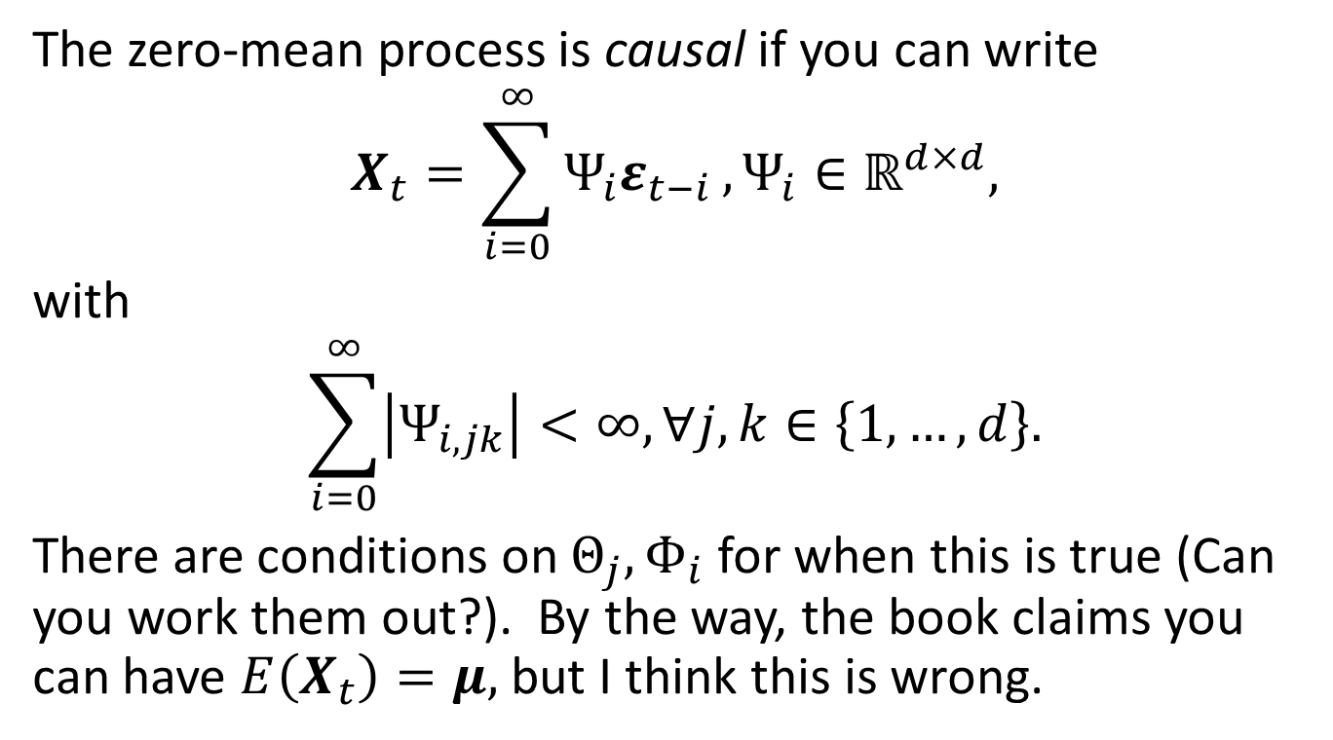
VARMA Process, cont’d
The zero-mean process is causal if you can write
$$X_{t}=\sum_{i=0}^{∞}{Ψ_{i}ε_{t−i}}, Ψ_{i}∈ℝ^{d×d},$$
with
$$\sum_{i=0}^{∞}{\left|Ψ_{i,jk}\right|}<∞, ∀j,k∈\left\{1,…,d\right\}.$$
There are conditions on $Θ_{j},Φ_{i}$ for when this is true (Can you work them out?). By the way, the book claims you can have $E\left(X_{t}\right)=μ,$ but I think this is wrong.

Slide 43
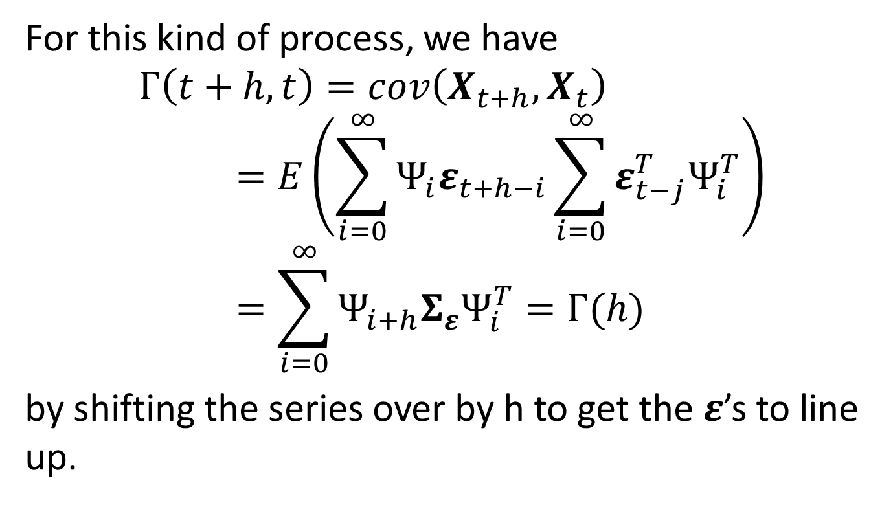
Causality, cont’d
For this kind of process, we have
$$Γ\left(t+h,t\right)=cov\left(X_{t+h},X_{t}\right)=E\left(\sum_{i=0}^{∞}{Ψ_{i}ε_{t+h−i}}\sum_{i=0}^{∞}{{ε_{t−j}^{T}Ψ}_{i}^{T}}\right)=\sum_{i=0}^{∞}{Ψ_{i+h}Σ_{ε}Ψ_{i}^{T}}=Γ(h)$$
by shifting the series over by h to get the $ε$’s to line up.

Slide 44
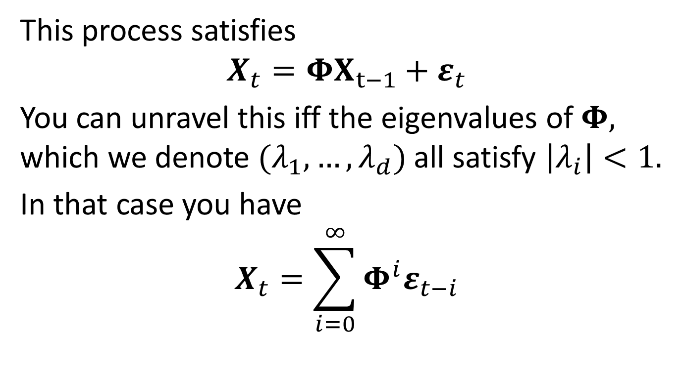
Simple Example - VAR(1)
This process satisfies
$$X_{t}=ΦX_{t−1}+ε_{t}$$
You can unravel this iff the eigenvalues of $Φ,$ which we denote $(λ_{1},…,λ_{d})$ all satisfy $\left|λ_{i}\right|<1.$
In that case you have
$$X_{t}=\sum_{i=0}^{∞}{Φ^{i}ε_{t−i}}$$

Slide 45
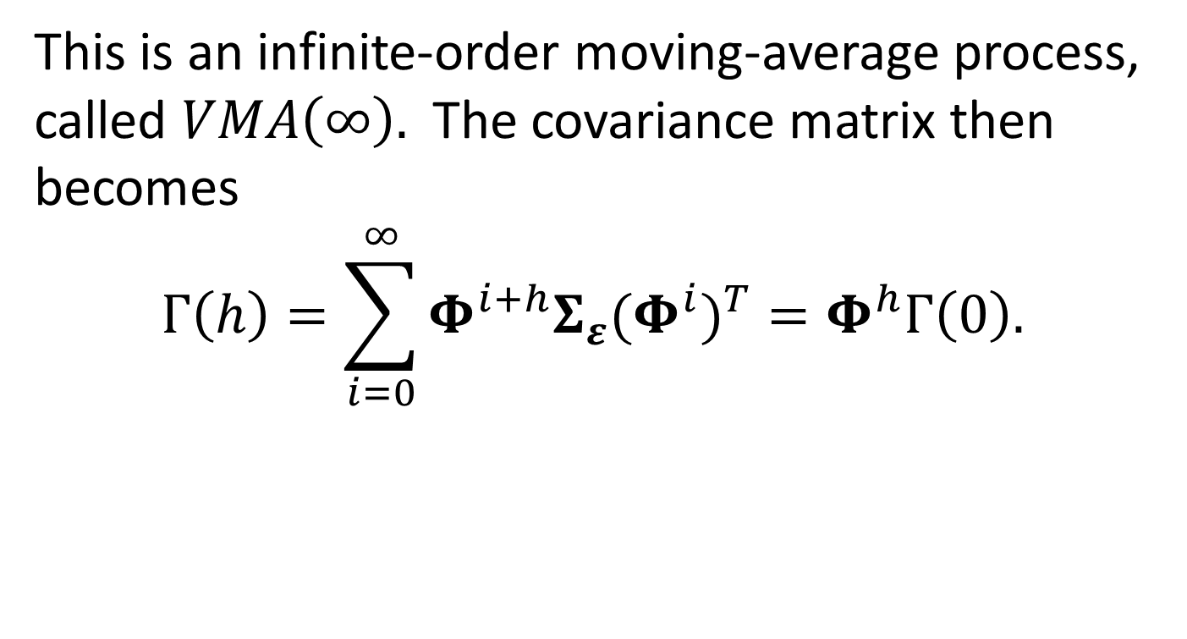
VAR(1), cont’d
This is an infinite-order moving-average process, called $VMA\left(∞\right).$ The covariance matrix then becomes
$$Γ\left(h\right)=\sum_{i=0}^{∞}{Φ^{i+h}Σ_{ε}{{(Φ}^{i})}^{T}}=Φ^{h}Γ\left(0\right).$$

Slide 46
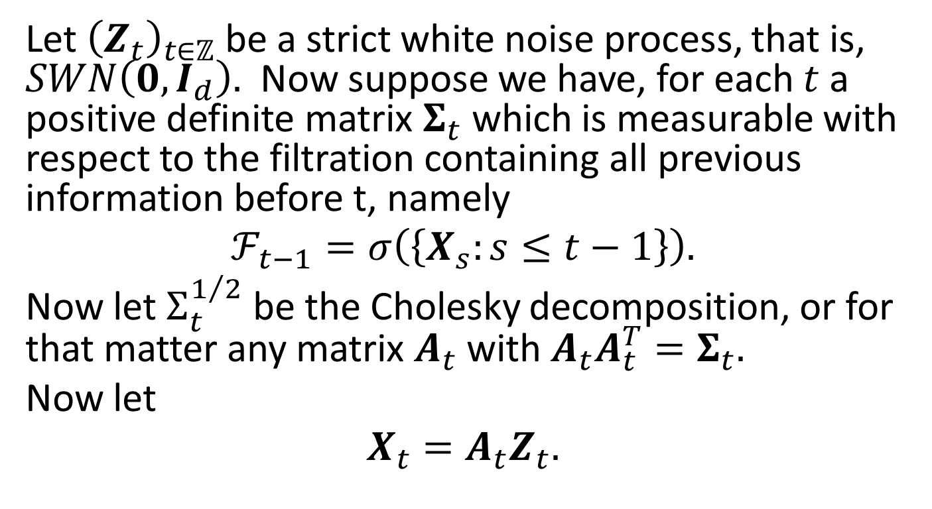
Multivariate GARCH
Let ${\left(Z_{t}\right)}_{t∈ℤ}$ be a strict white noise process, that is, $SWN\left(0,I_{d}\right).$ Now suppose we have, for each $t$a positive definite matrix $Σ_{t}$ which is measurable with respect to the filtration containing all previous information before t, namely
$$ℱ_{t−1}=σ\left(\left\{X_{s}:s≤t−1\right\}\right).$$
Now let $Σ_{t}^{1/2}$ be the Cholesky decomposition, or for that matter any matrix $A_{t}$ with $A_{t}A_{t}^{T}=Σ_{t}.$
Now let
$$X_{t}=A_{t}Z_{t}.$$

Slide 47
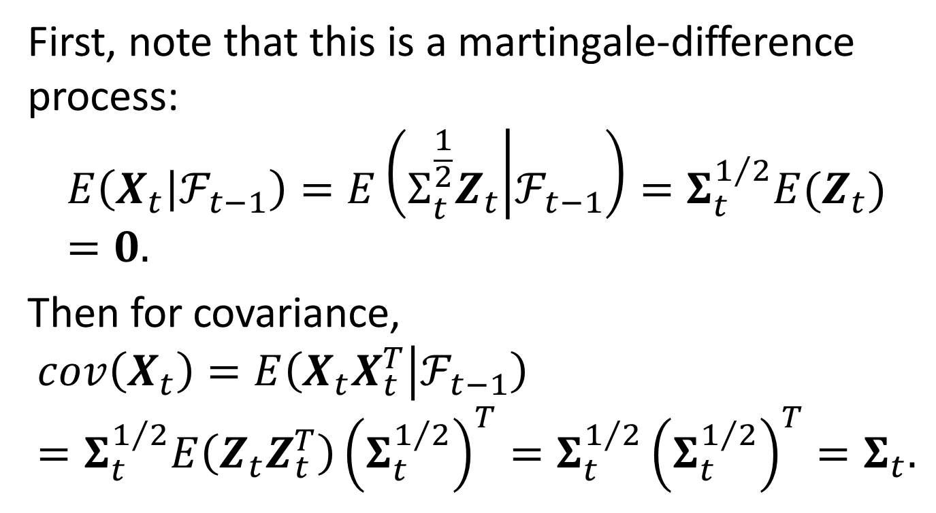
Conditional Mean and Covariance
First, note that this is a martingale-difference process:
$$E\left(X_{t} | ℱ_{t−1}\right)=E\left(Σ_{t}^{\frac{1}{2}}Z_{t} | ℱ_{t−1}\right)=Σ_{t}^{1/2}{E(Z}_{t})=0.$$
Then for covariance,
$$cov\left(X_{t}\right)=E\left(X_{t}X_{t}^{T} | ℱ_{t−1}\right)=Σ_{t}^{1/2}E\left(Z_{t}Z_{t}^{T}\right){\left(Σ_{t}^{1/2}\right)}^{T}=Σ_{t}^{1/2}{\left(Σ_{t}^{1/2}\right)}^{T}=Σ_{t}.$$

Slide 48
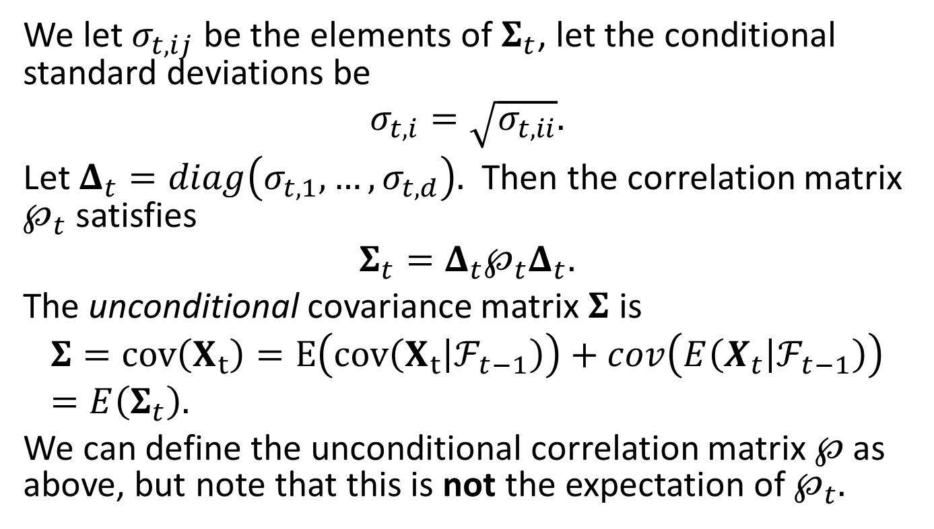
Conditional Correlation
We let $σ_{t,ij}$ be the elements of $Σ_{t}$, let the conditional standard deviations be
$$σ_{t,i}=\sqrt{σ_{t,ii}}.$$
Let $Δ_{t}=diag\left(σ_{t,1},…,σ_{t,d}\right).$ Then the correlation matrix $℘_{t}$ satisfies
$$Σ_{t}=Δ_{t}℘_{t}Δ_{t}.$$
The unconditional covariance matrix $Σ$ is
$$Σ=cov\left(X_{t}\right)=E\left(cov\left(X_{t} | ℱ_{t−1}\right)\right)+cov\left(E\left(X_{t} | ℱ_{t−1}\right)\right)=E\left(Σ_{t}\right).$$
We can define the unconditional correlation matrix $℘$as above, but note that this is not the expectation of $℘_{t}.$

Slide 49
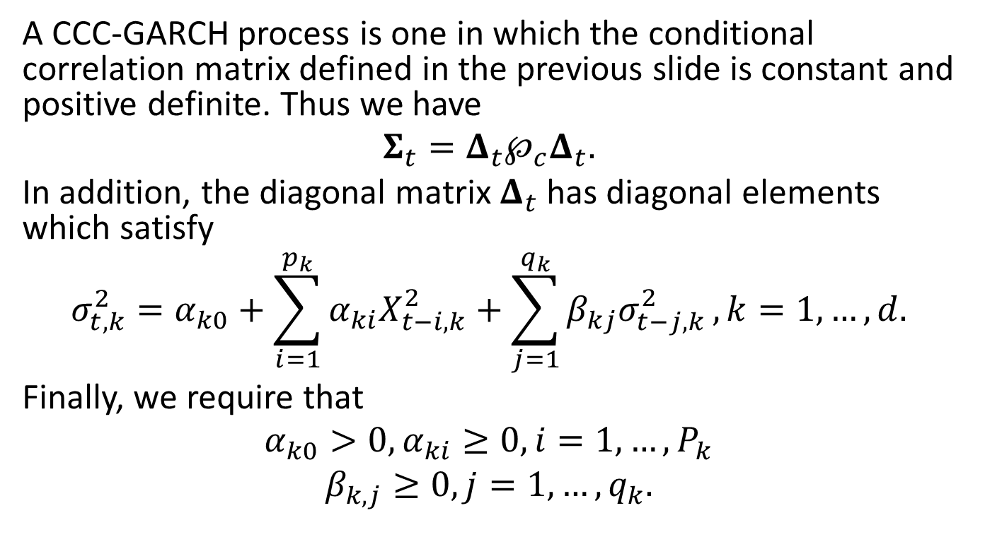
CCC-GARCH
A CCC-GARCH process is one in which the conditional correlation matrix defined in the previous slide is constant and positive definite. Thus we have
$$Σ_{t}=Δ_{t}℘_{c}Δ_{t}.$$
In addition, the diagonal matrix $Δ_{t}$ has diagonal elements which satisfy
$$σ_{t,k}^{2}=α_{k0}+\sum_{i=1}^{p_{k}}{α_{ki}X_{t−i,k}^{2}}+\sum_{j=1}^{q_{k}}{β_{kj}σ_{t−j,k}^{2}}, k=1,…,d.$$
Finally, we require that
$$α_{k0}>0,α_{ki}≥0,i=1,…,P_{k}$$
$$β_{k,j}≥0, j=1,…,q_{k}.$$

Slide 50
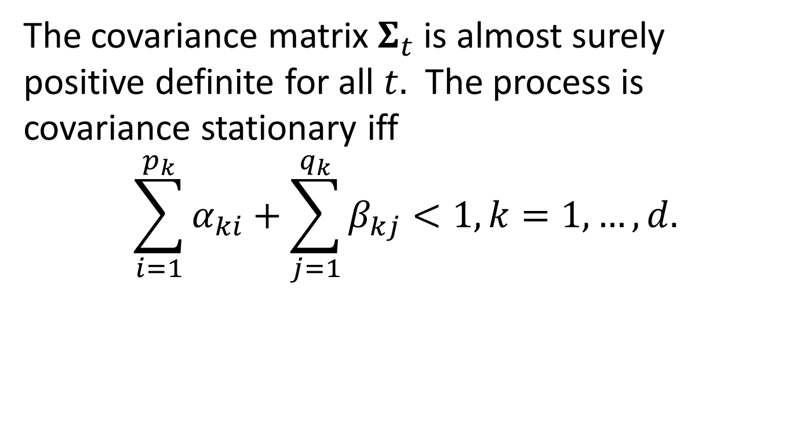
A Proposition
The covariance matrix $Σ_{t}$ is almost surely positive definite for all $t.$ The process is covariance stationary iff
$$\sum_{i=1}^{p_{k}}{α_{ki}}+\sum_{j=1}^{q_{k}}{β_{kj}}<1, k=1,…,d.$$

Slide 51
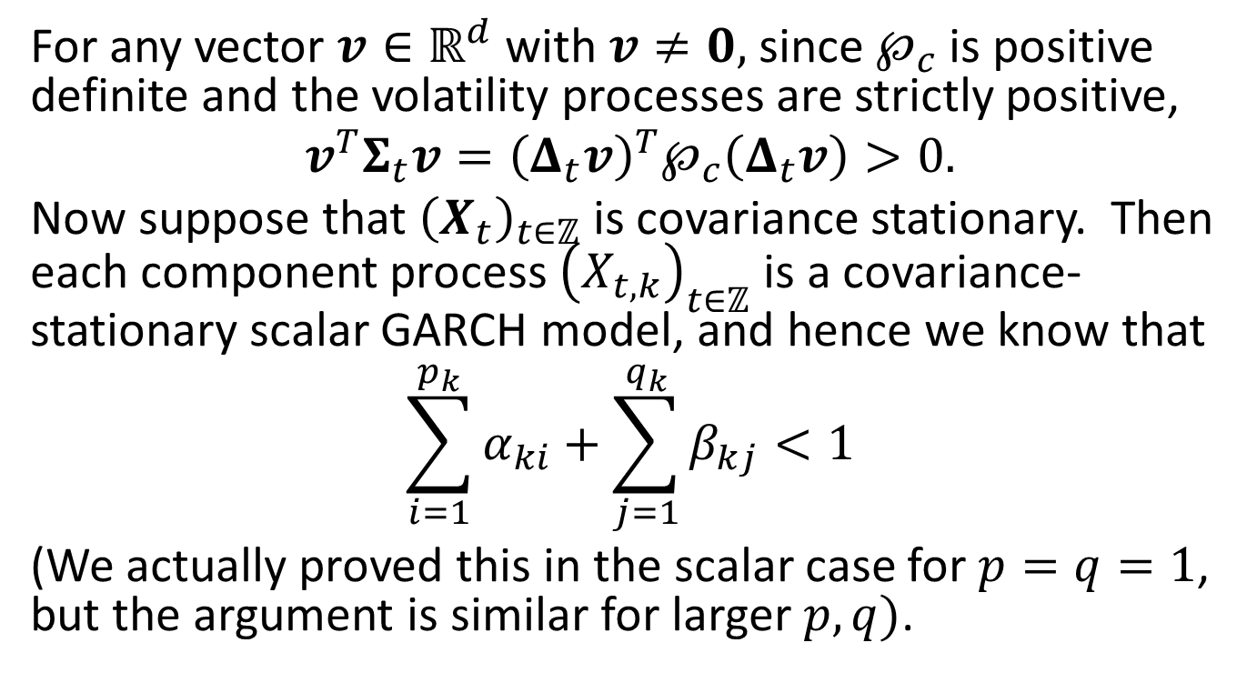
Proof of the Proposition
For any vector $v∈ℝ^{d}$with $v≠0,$ since $℘_{c}$ is positive definite and the volatility processes are strictly positive,
$$v^{T}Σ_{t}v={\left(Δ_{t}v\right)}^{T}℘_{c}\left(Δ_{t}v\right)>0.$$
Now suppose that ${\left(X_{t}\right)}_{t∈ℤ}$ is covariance stationary. Then each component process ${\left(X_{t,k}\right)}_{t∈ℤ}$ is a covariance-stationary scalar GARCH model, and hence we know that
$$\sum_{i=1}^{p_{k}}{α_{ki}}+\sum_{j=1}^{q_{k}}{β_{kj}}<1$$
(We actually proved this in the scalar case for $p=q=1$, but the argument is similar for larger $p,q)$.

Slide 52
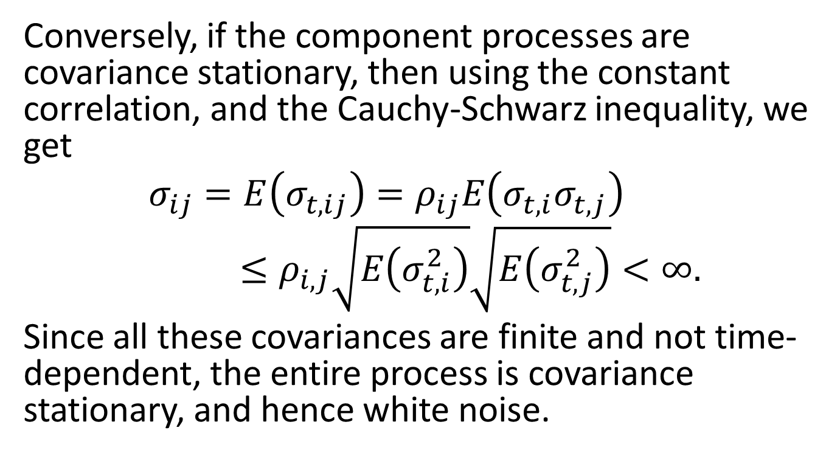
Proposition, cont’d
Conversely, if the component processes are covariance stationary, then using the constant correlation, and the Cauchy-Schwarz inequality, we get
$$σ_{ij}=E\left(σ_{t,ij}\right)=ρ_{ij}E\left(σ_{t,i}σ_{t,j}\right)≤ρ_{i,j}\sqrt{E\left(σ_{t,i}^{2}\right)}\sqrt{E\left(σ_{t,j}^{2}\right)}<∞.$$
Since all these covariances are finite and not time-dependent, the entire process is covariance stationary, and hence white noise.

Slide 53
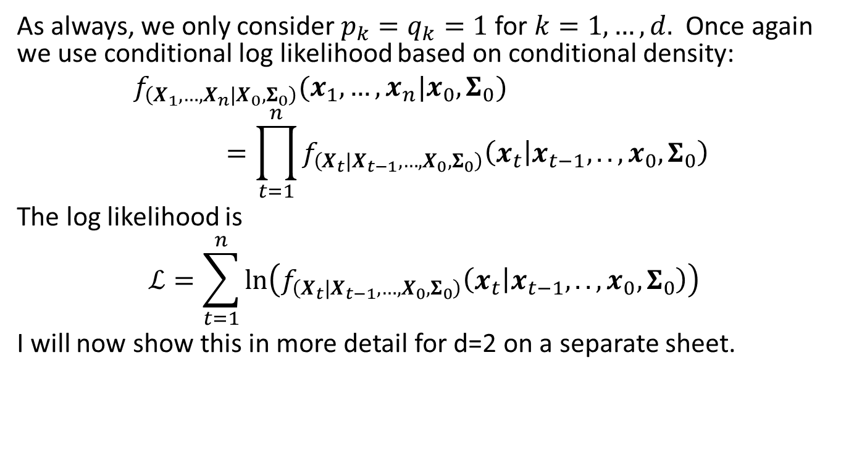
Fitting a CCC-GARCH(1,1) model
As always, we only consider $p_{k}=q_{k}=1$for $k=1,…,d.$ Once again we use conditional log likelihood based on conditional density:
$$f_{\left(X_{1},…,X_{n} | X_{0},Σ_{0}\right)}(x_{1},…,x_{n}|x_{0},Σ_{0})=\prod_{t=1}^{n}{f_{\left(X_{t} | X_{t−1},…,X_{0},Σ_{0}\right)}\left(x_{t} | x_{t−1},..,x_{0},Σ_{0}\right) }$$
The log likelihood is
$$ℒ=\sum_{t=1}^{n}{\ln\left(f_{\left(X_{t} | X_{t−1},…,X_{0},Σ_{0}\right)}\left(x_{t} | x_{t−1},..,x_{0},Σ_{0}\right)\right)}$$
I will now show this in more detail for d=2 on a separate sheet.

